Slide 1
How to validate model?
資料科學 Data Science
張家銘 Jia-Ming Chang
政治大學資訊科學系
The slide isonly for educational purposes. If any infringement, please contact me, we will correct immediately.

Slide 2
Copyright declaration 版權說明
Some of the figures in this presentation are taken from "An Introduction to Statistical Learning, with applications in R" (Springer, 2013) with permission from the authors: G. James, D. Witten, T. Hastie and R. Tibshirani.
The web site of the book
The credit of individual is indicated in the bottom part of the slide.
ie.,

Slide 3
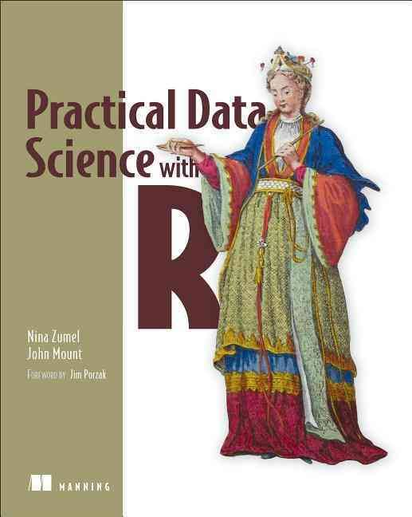
Copyright declaration 版權說明
Some of the figures in this presentation are taken from "Practical Data Science with R (Manning, 2019)”
The web site of the book
The credit of individual is indicated in the bottom part of the slide.
ie.,

Slide 4
Copyright declaration 版權說明
Some of the figures in this presentation are taken from "R for Data Science” under the Creative Commons Attribution-NonCommercial-NoDerivs 3.0 License.
The web site of the book
The credit of individual is indicated in the bottom part.
ie.,

Slide 5
Recap for the last week

Slide 6
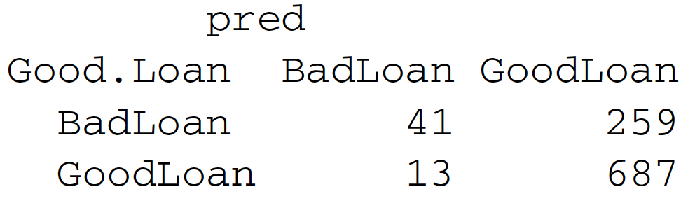
Confusion Matrix
Definition
True positive
False positive
True negative
False negative
TP
FN
FP
TN
Practical Data Science with R by Nina Zumel, John Mount
Notes:
Why it important => show example to show some bias!

Slide 7
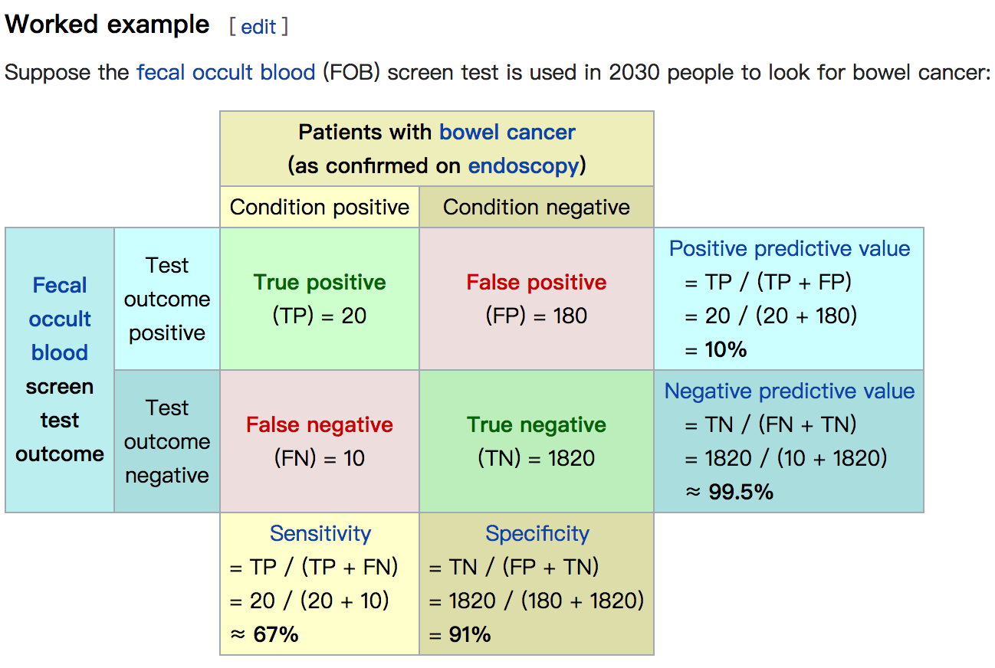
Credit by https://en.wikipedia.org/wiki/Positive_and_negative_predictive_values

Slide 8
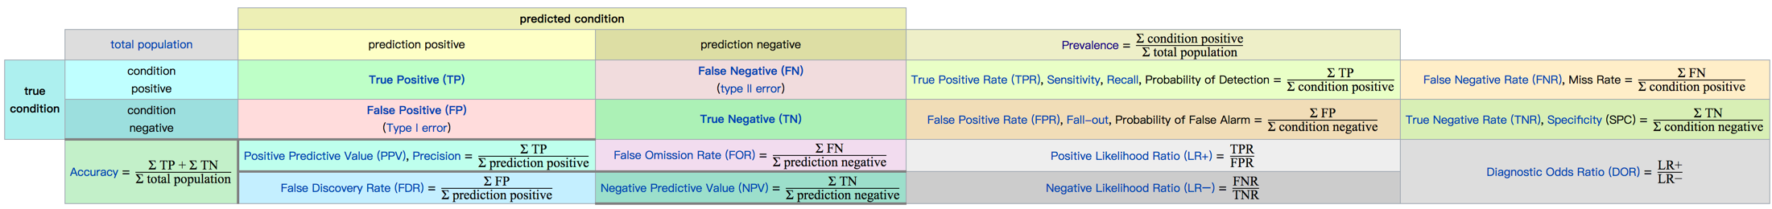
Credit by https://en.wikipedia.org/wiki/Positive_and_negative_predictive_values

Slide 9
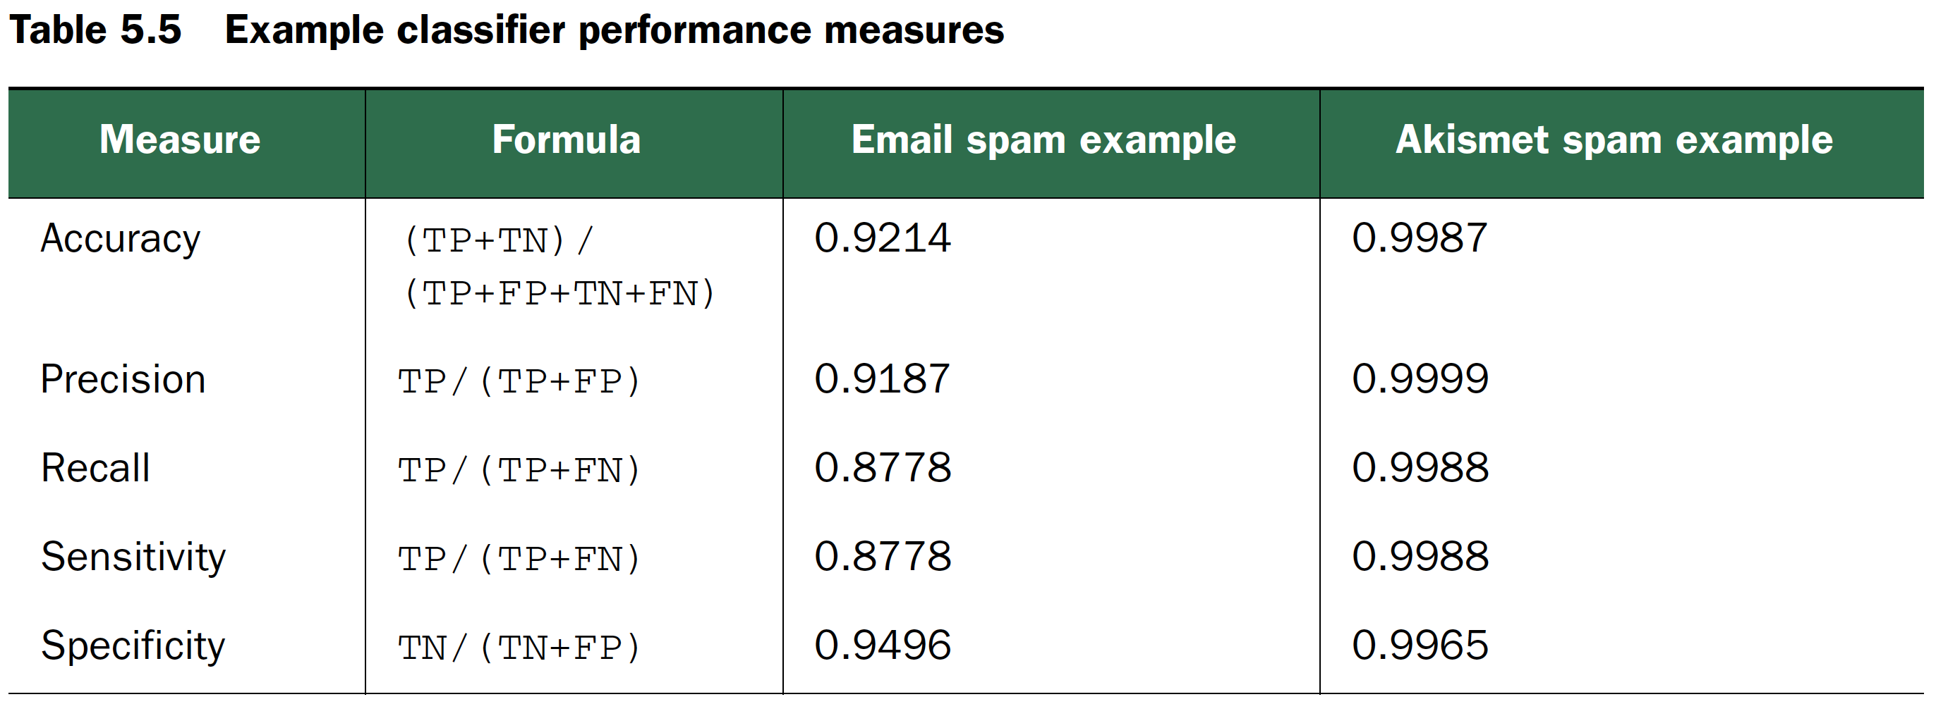
Common Classification Performance Measures
Practical Data Science with R by Nina Zumel, John Mount

Slide 10
Credit by https://en.wikipedia.org/wiki/Sensitivity_and_specificity

Slide 11
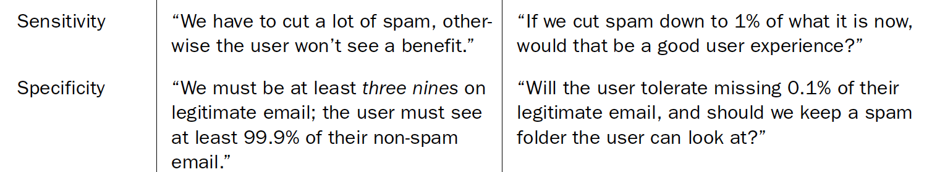
Common Classification Performance Measure
Recommend writing the business goals as maximizing sensitivity while maintaining a specificity of at least 0.999
Recommend writing the business goals as maximizing specificity while maintaining a of sensitivity at least 0.999
Practical Data Science with R by Nina Zumel, John Mount

Slide 12
Evaluating scoring models
RMSE
sqrt(mean((prediction-actualValues)^2))
R-SQUARED, R²
1 - sum((pred-actVal)^2)/sum((mean(actVal)-actVal)^2)
R-squared = correlation²

Slide 13
R-squared = correlation²
Under “general conditions”, as Wikipedia says, R² is also the square of the correlation between the actual and predicted outcomes.
f is the model that minimizes squared-error loss
Because it is the optimum (in the sense of item 1), there is no shift of f that will improve the fit.
Because it is the optimum (in the sense of item 1), there is no scaling of f that will improve the fit.
Credit by Win-Vector Blog http://www.win-vector.com/blog/2011/11/correlation-and-r-squared/

Slide 14
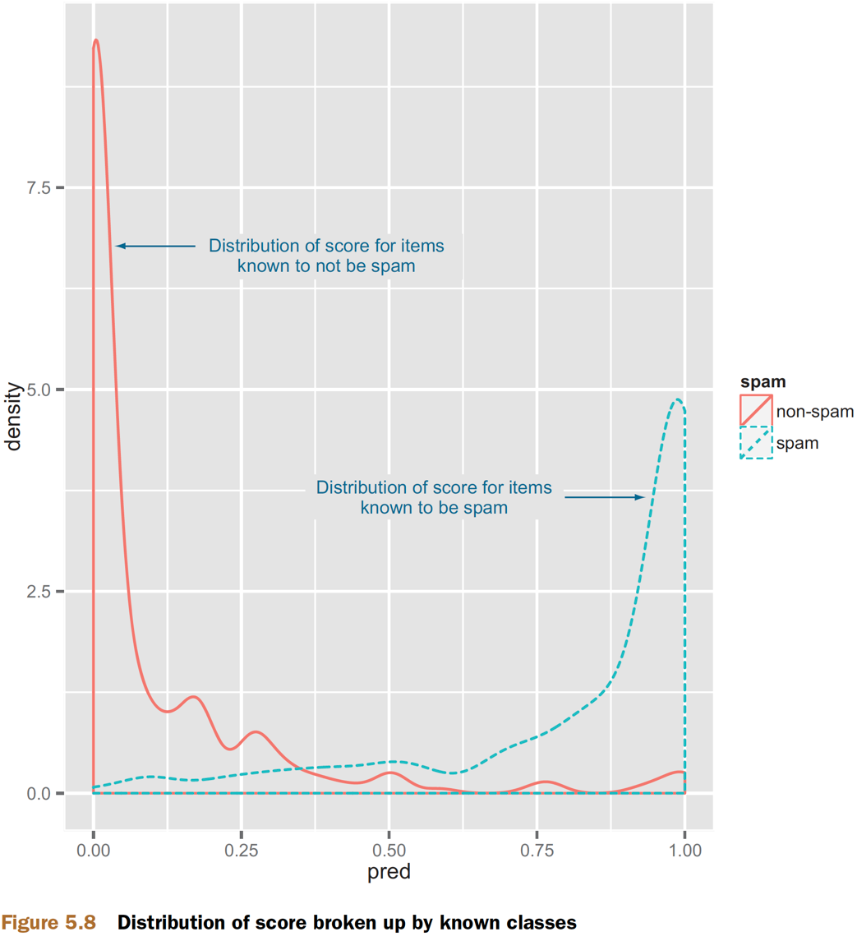
Evaluating probability models
Figure5.8, Practical Data Science with R by Nina Zumel, John Mount

Slide 15
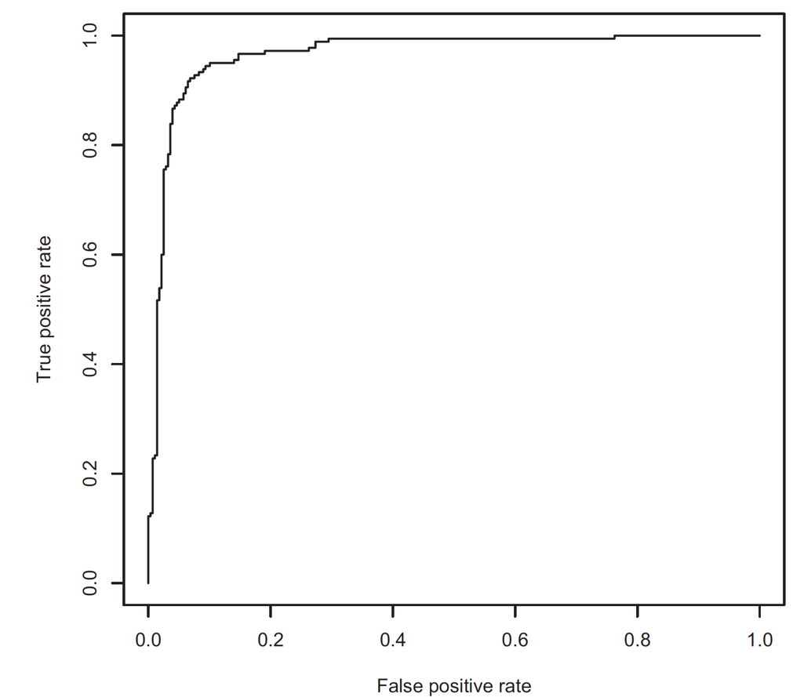
The Receiver Operating Characteristic Curve
ROC curve
AUC or area under the curve
Figure5.9, Practical Data Science with R by Nina Zumel, John Mount

Slide 16
More on ROC/AUC
The ROC curve is a useful tool, but you have to use it for appropriate tasks.
The ROC curve is useful tool designing a classifier from a scoring function (though I prefer the “double hump graph”).

Slide 17
More on ROC/AUC
Credit by Win-Vector Blog, http://www.win-vector.com/blog/2013/01/more-on-rocauc/

Slide 18
More on ROC/AUC
the speed the score parameter is moving along the curve and what density of data is associate with each score.
you get the first 1/2 units of area for free (no credit to you there) it is only the second 1/2 that is at all meaningful.
Credit by Win-Vector Blog, http://www.win-vector.com/blog/2013/01/more-on-rocauc/

Slide 19
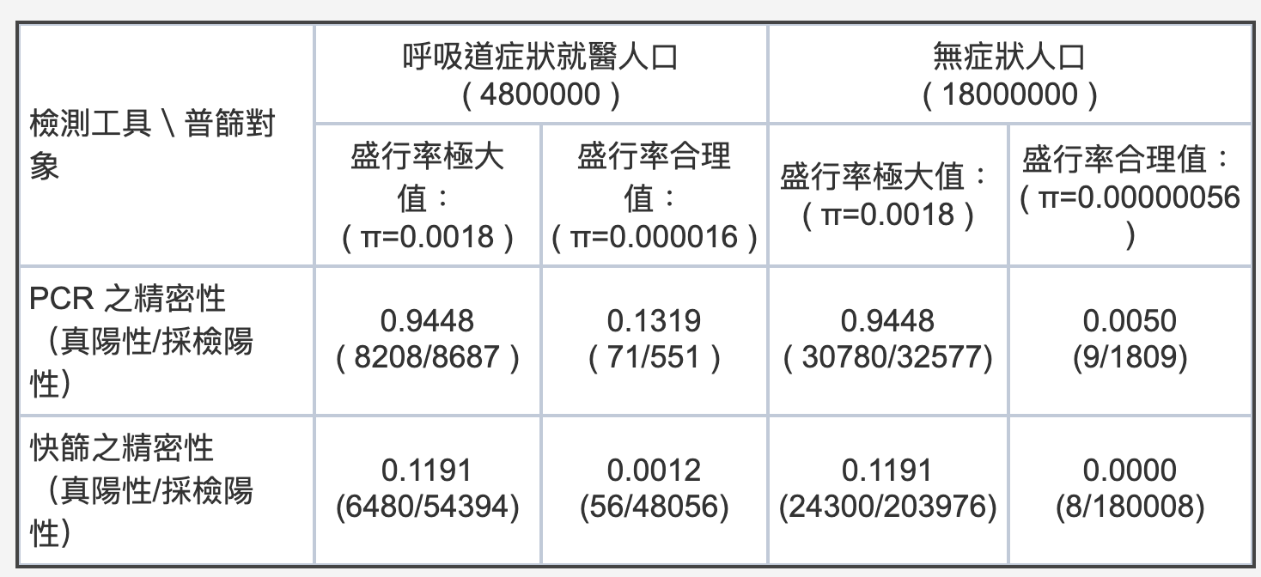
報告中 PCR 及快篩的精密性
Credit by 林澤民 https://pansci.asia/archives/185201

Slide 20
Today
appendix B: Important statistical concepts
Cha 02. Statistical Learning
Cha 07. Model Assessment and Selection

Slide 21
Outline
Bias-variance decomposition
Overfitting
Three-way cross validation
Lower/upper bound
Null model, p-value
A/B test
Chi-squared/Fisher’s exact test

Slide 22
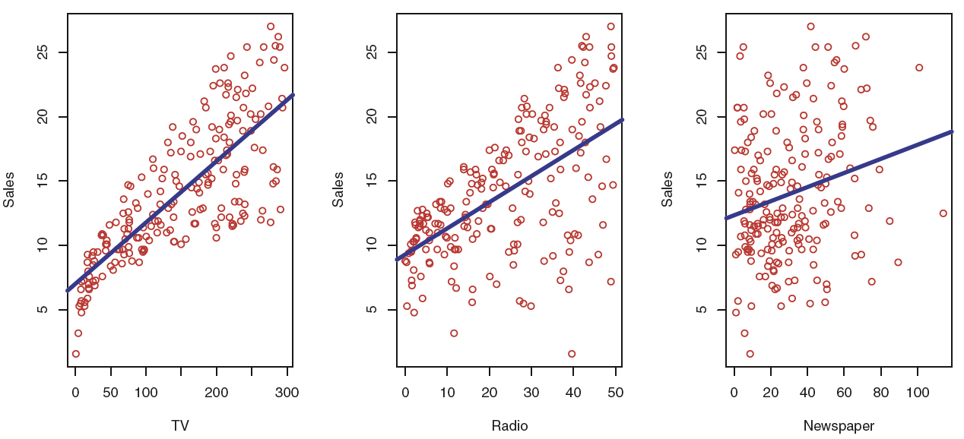

$$\hat{Y}=\hat{f}\left(X\right)$$
Given {(x₁, y₁), (x₂, y₂), . . . , (x_{n}, y_{n}) } where x_{i} = (x_{i1}, x_{i2}, . . . , x_{ip})^{T}
Figure 2.1, An Introduction to Statistical Learning with Applications in R by Gareth James, Daniela Witten, Trevor Hastie, Robert Tibshirani

Slide 23
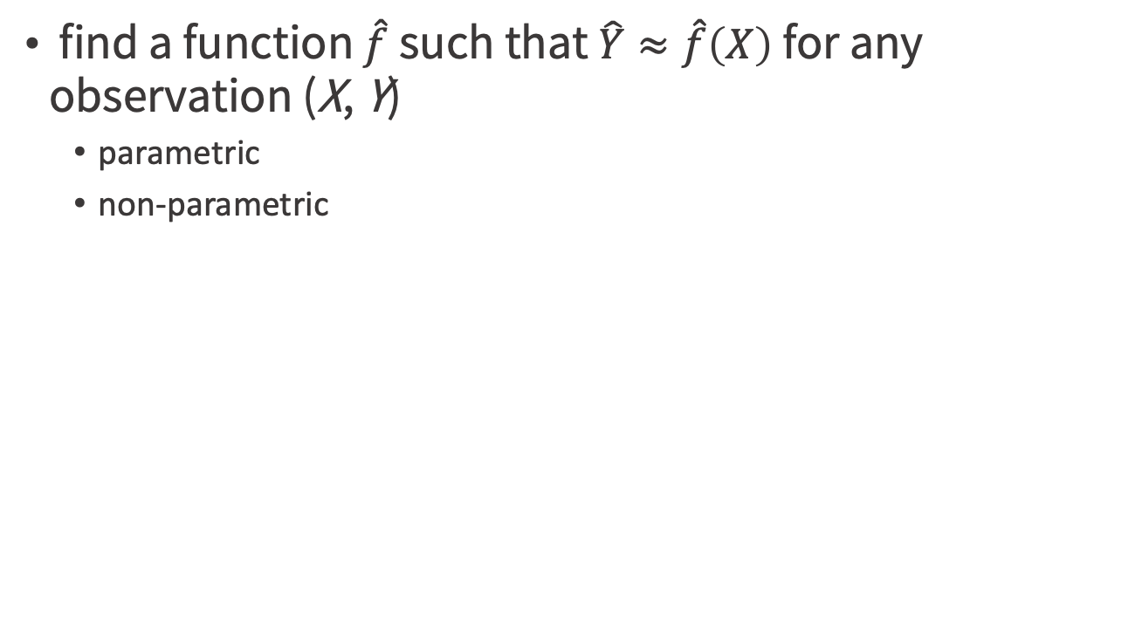
How Do We Estimate f?
find a function $\hat{f}$ such that $\hat{Y}≈\hat{f}\left(X\right)$for any observation (X, Y)
parametric
non-parametric
An Introduction to Statistical Learning with Applications in R by Gareth James, Daniela Witten, Trevor Hastie, Robert Tibshirani

Slide 24
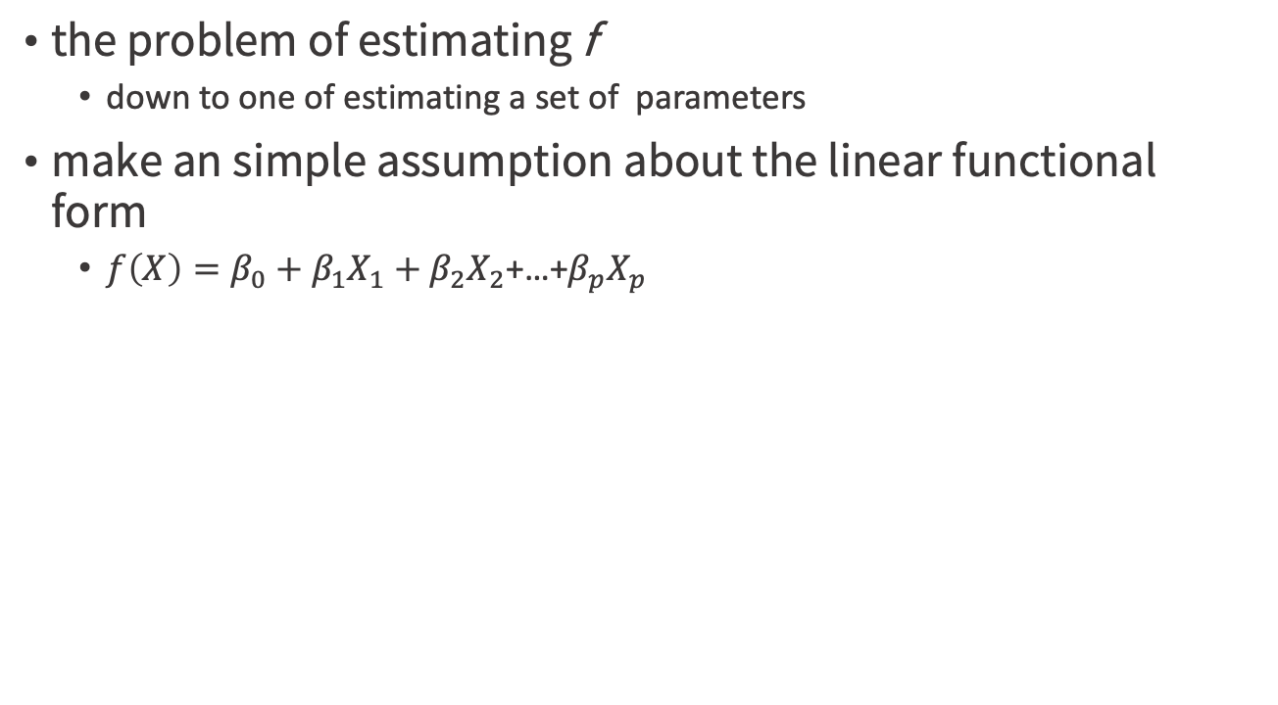
Parametric Methods
the problem of estimating f
down to one of estimating a set of parameters
make an simple assumption about the linear functional form
$f\left(X\right)=β_{0}+β_{1}X_{1}+β_{2}X_{2}$+…+$β_{p}X_{p}$
An Introduction to Statistical Learning with Applications in R by Gareth James, Daniela Witten, Trevor Hastie, Robert Tibshirani

Slide 25
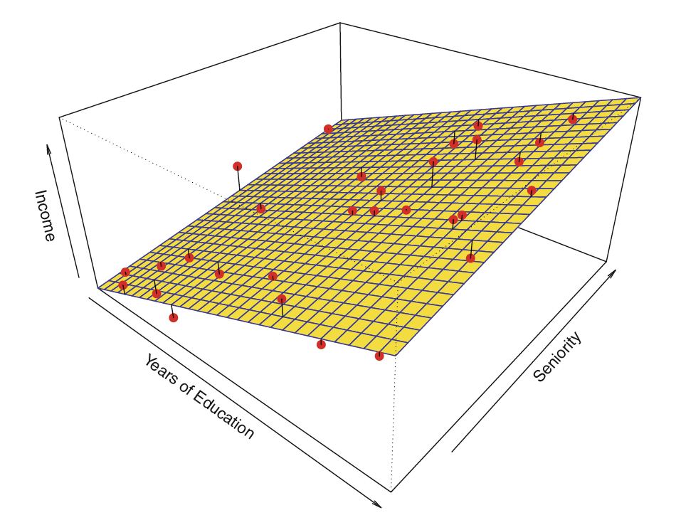
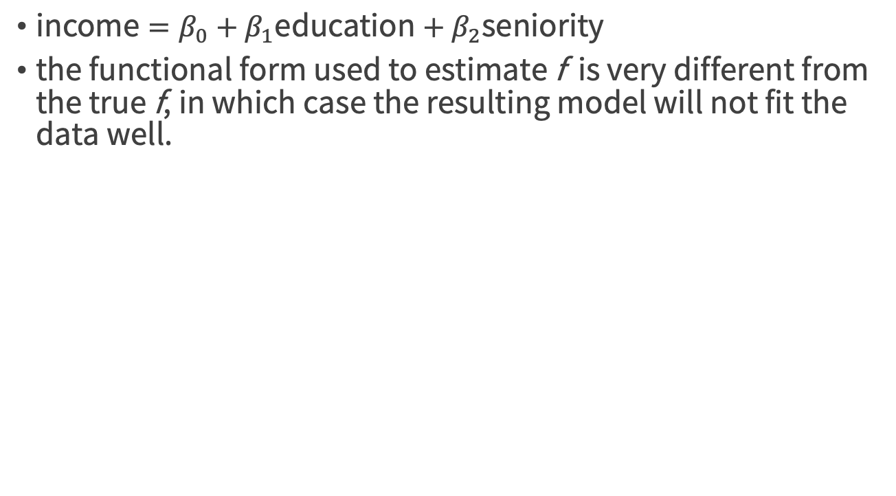
Parametric Methods
$\text{income}=β_{0}+β_{1}\text{education}+β_{2}\text{seniority}$
the functional form used to estimate f is very different from the true f, in which case the resulting model will not fit the data well.
Figure 2.4, An Introduction to Statistical Learning with Applications in R by Gareth James, Daniela Witten, Trevor Hastie, Robert Tibshirani

Slide 26
Non-parametric Methods
do not make explicit assumptions about the functional form of f
they have the potential to accurately fit a wider range of possible shapes for f
do not reduce the problem of estimating f to a small number of parameters, a very large number of observations (far more than is typically needed for a parametric approach) is required in order to obtain an accurate estimate for f
An Introduction to Statistical Learning with Applications in R by Gareth James, Daniela Witten, Trevor Hastie, Robert Tibshirani

Slide 27
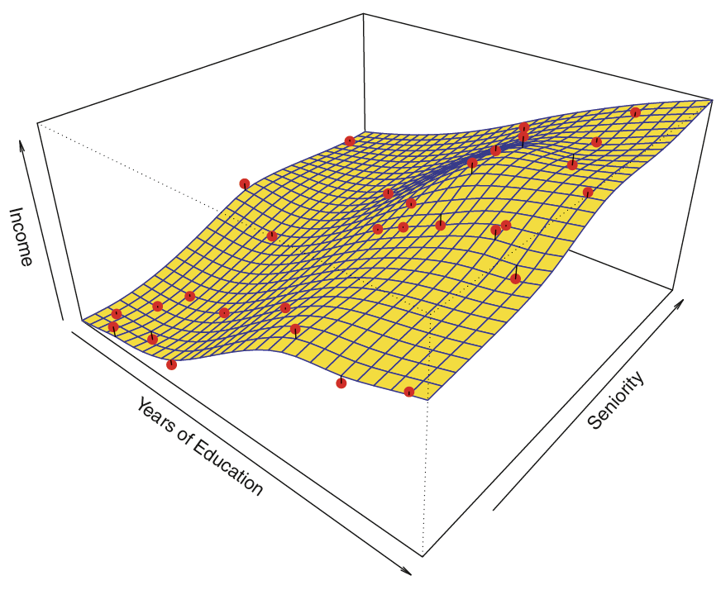
A smooth thin-plate spline fit
Figure 2.5, An Introduction to Statistical Learning with Applications in R by Gareth James, Daniela Witten, Trevor Hastie, Robert Tibshirani

Slide 28
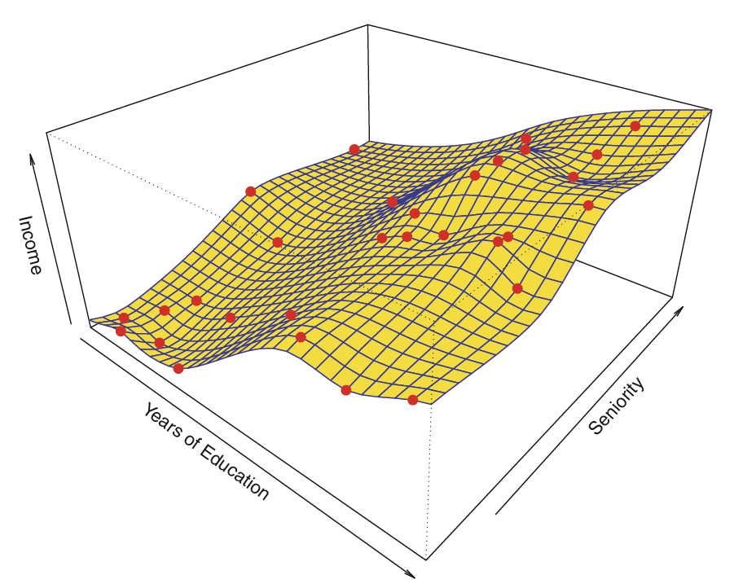
Which model fits well?
Figure 2.4,2.5,2.6, An Introduction to Statistical Learning with Applications in R by Gareth James, Daniela Witten, Trevor Hastie, Robert Tibshirani

Slide 29
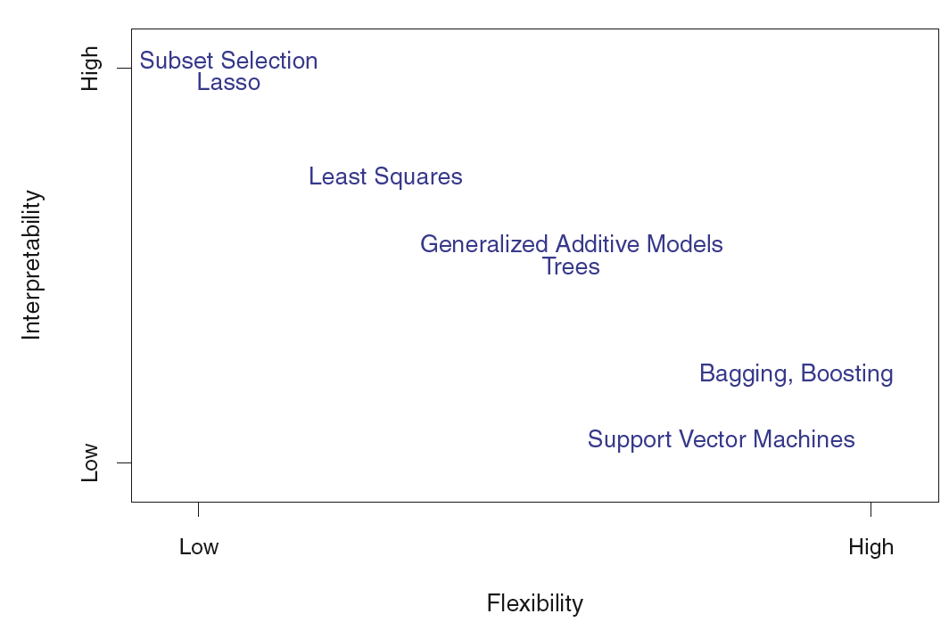
Prediction Accuracy v.s. Model Interpretability
Figure 2.7, An Introduction to Statistical Learning with Applications in R by Gareth James, Daniela Witten, Trevor Hastie, Robert Tibshirani

Slide 30
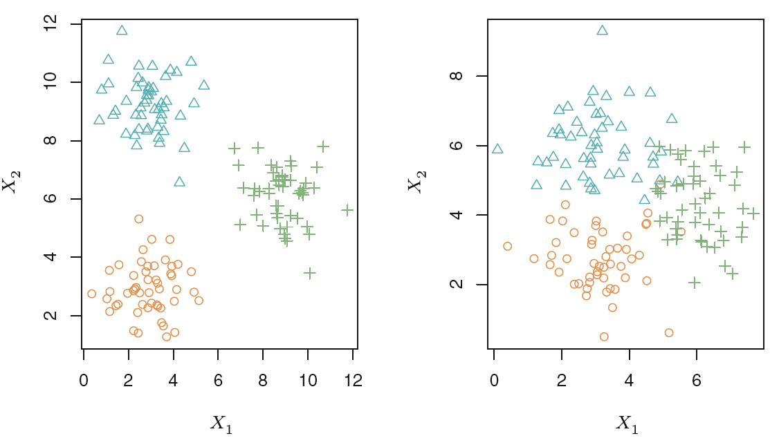
Which one is more challenging?
Figure 2.8, An Introduction to Statistical Learning with Applications in R by Gareth James, Daniela Witten, Trevor Hastie, Robert Tibshirani

Slide 31
Model quality
Bias-Variance Decomposition

Slide 32
Goal
Model selection
estimating the performance of different models in order to choose the best one.
Model assessment
having chosen a final model, estimating its prediction error (generalization error) on new data.
the testing of a model on new data => will it show similar quality on new data in production?
Credit by The Elements of Statistical Learning Trevor Hastie, Robert Tibshirani, Jerome Friedman

Slide 33
Statistical theory
EXCHANGEABILITY: for any permutation j₁,...j_{m} of 1,…,m , the joint probability of seeing x[i,],y[i] is equal to the joint probability of seeing x[j_{i},],y[j_{i}].
so, we can make train/test splits => even train/calibrate/test splits ?
once you look at your test data, it’s less exchangeable with what will be seen in production in the future (discuss in cross-validation)

Slide 34
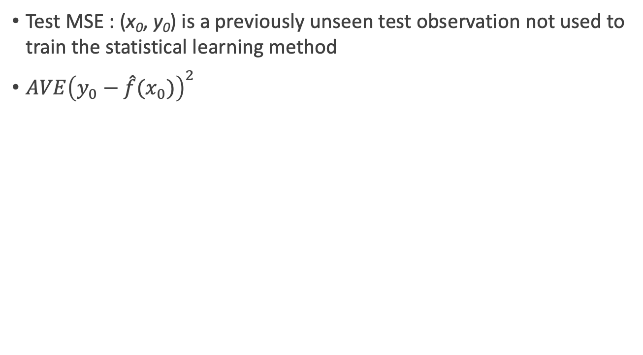
Training v.s. Testing error
Test MSE : (x₀, y₀) is a previously unseen test observation not used to train the statistical learning method
$AVE{\left(y_{0}−\hat{f}(x_{0})\right)}^{2}$
An Introduction to Statistical Learning with Applications in R by Gareth James, Daniela Witten, Trevor Hastie, Robert Tibshirani

Slide 35
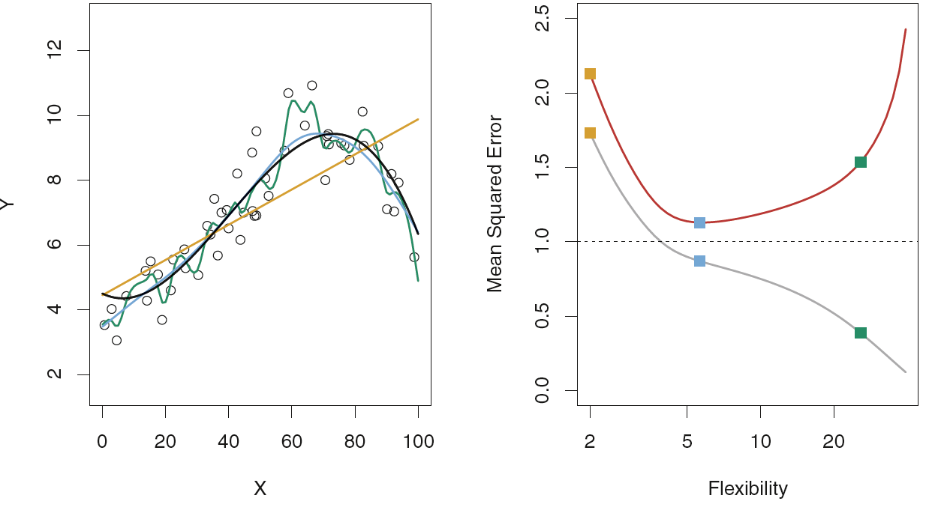
Three estimates of f
Which line is Training Error? Testing Error?
There is no guarantee that the method with the lowest training MSE will also have the lowest test MSE.
Figure2.9,An Introduction to Statistical Learning with Applications in R by Gareth James, Daniela Witten, Trevor Hastie,Robert Tibshirani

Slide 36
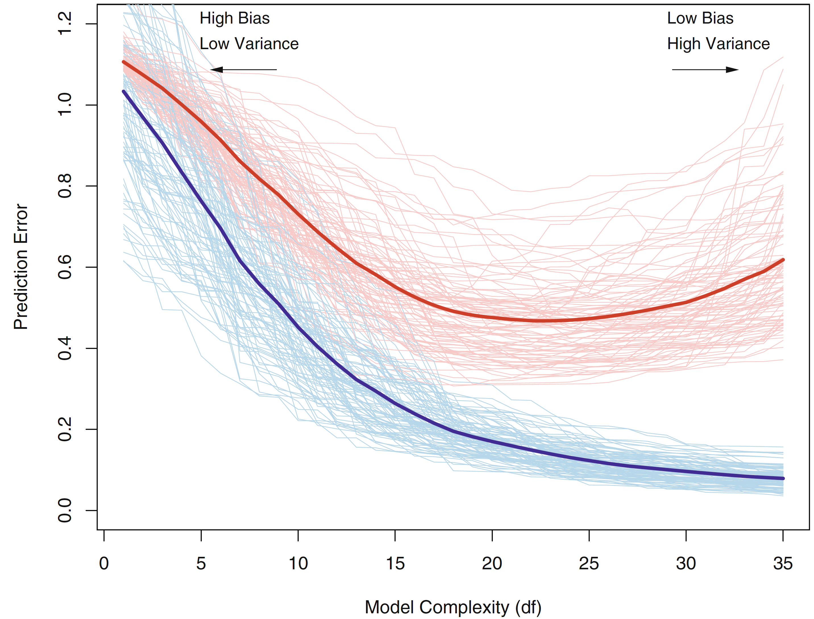
As the model complexity is increased
The light blue curves = the training error err
The light red curves = the conditional test error for 100 training sets of size 50 each
The solid curves = the expected test error and the expected training error
Credit by The Elements of Statistical Learning Trevor Hastie, Robert Tibshirani, Jerome Friedman

Slide 37
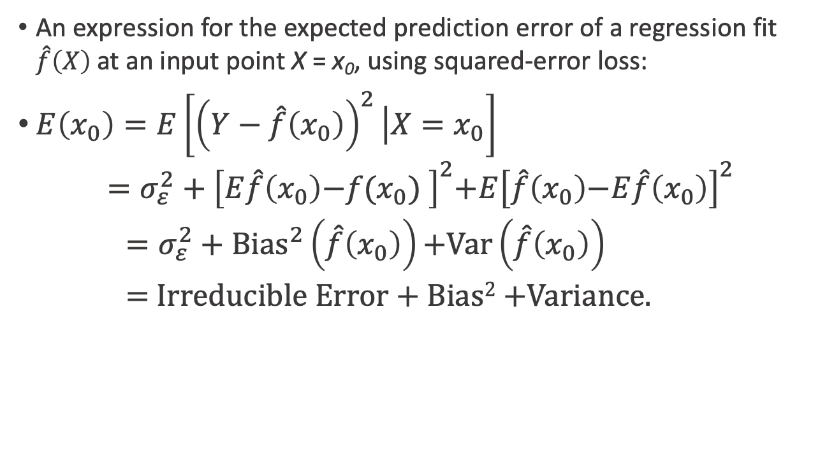
Bias-Variance Decomposition for expected test MSE
An expression for the expected prediction error of a regression fit $\hat{f}\left(X\right)$at an input point X = x₀, using squared-error loss:
$E\left(x_{0}\right)=E\left[{\left(Y−\hat{f}\left(x_{0}\right)\right)}^{2}\left|X=x_{0}\right.\right]$
$$=σ_{ε}^{2}+{\left[E\hat{f}\left(x_{0}\right)\text{−}f\text{(}x_{0}\text{)} \right]}^{2}\text{+}E{\left[\hat{f}\left(x_{0}\right)\text{−}E\hat{f}\left(x_{0}\right)\right]}^{2}$$
$=σ_{ε}^{2}+{\text{Bias}}^{2}\left(\hat{f}\left(x_{0}\right)\right)\text{+}\text{Var}\left(\hat{f}\left(x_{0}\right)\right)$
= Irreducible Error + Bias² +Variance.
Credit by The Elements of Statistical Learning Trevor Hastie, Robert Tibshirani, Jerome Friedman

Slide 38
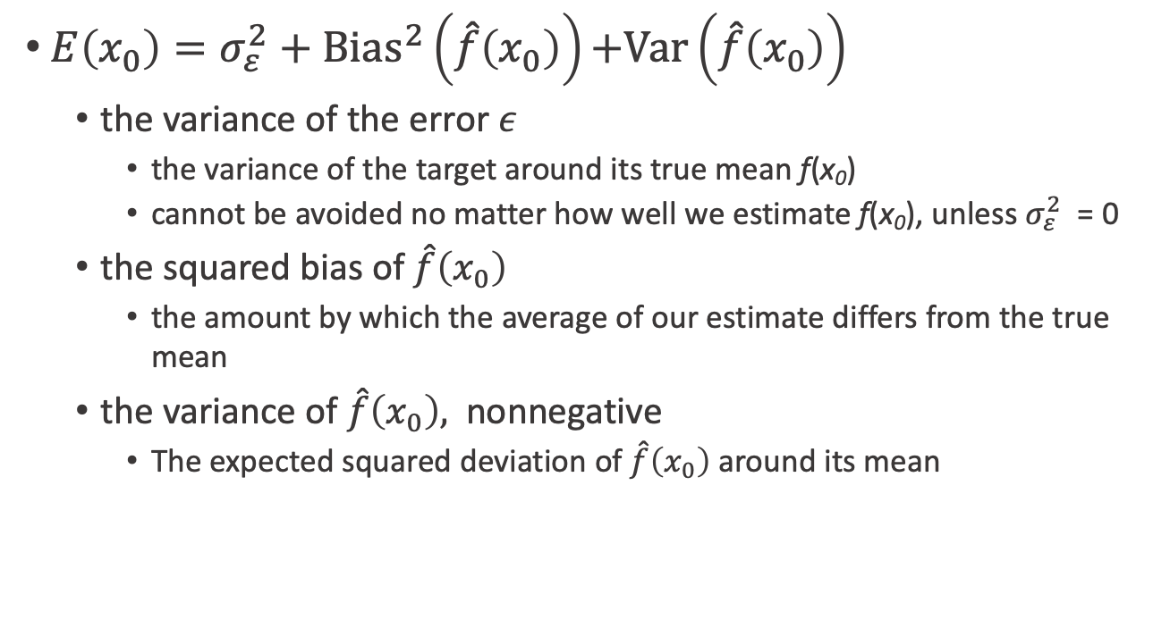
Bias-Variance Decomposition
$E\left(x_{0}\right)=σ_{ε}^{2}+{\text{Bias}}^{2}\left(\hat{f}\left(x_{0}\right)\right)\text{+}\text{Var}\left(\hat{f}\left(x_{0}\right)\right)$
the variance of the error $ε$
the variance of the target around its true mean f(x₀)
cannot be avoided no matter how well we estimate f(x₀), unless $σ_{ε}^{2}$ = 0
the squared bias of $\hat{f}\left(x_{0}\right)$
the amount by which the average of our estimate differs from the true mean
the variance of $\hat{f}\left(x_{0}\right),$ nonnegative
The expected squared deviation of $\hat{f}\left(x_{0}\right)$ around its mean
Credit by The Elements of Statistical Learning Trevor Hastie, Robert Tibshirani, Jerome Friedman

Slide 39
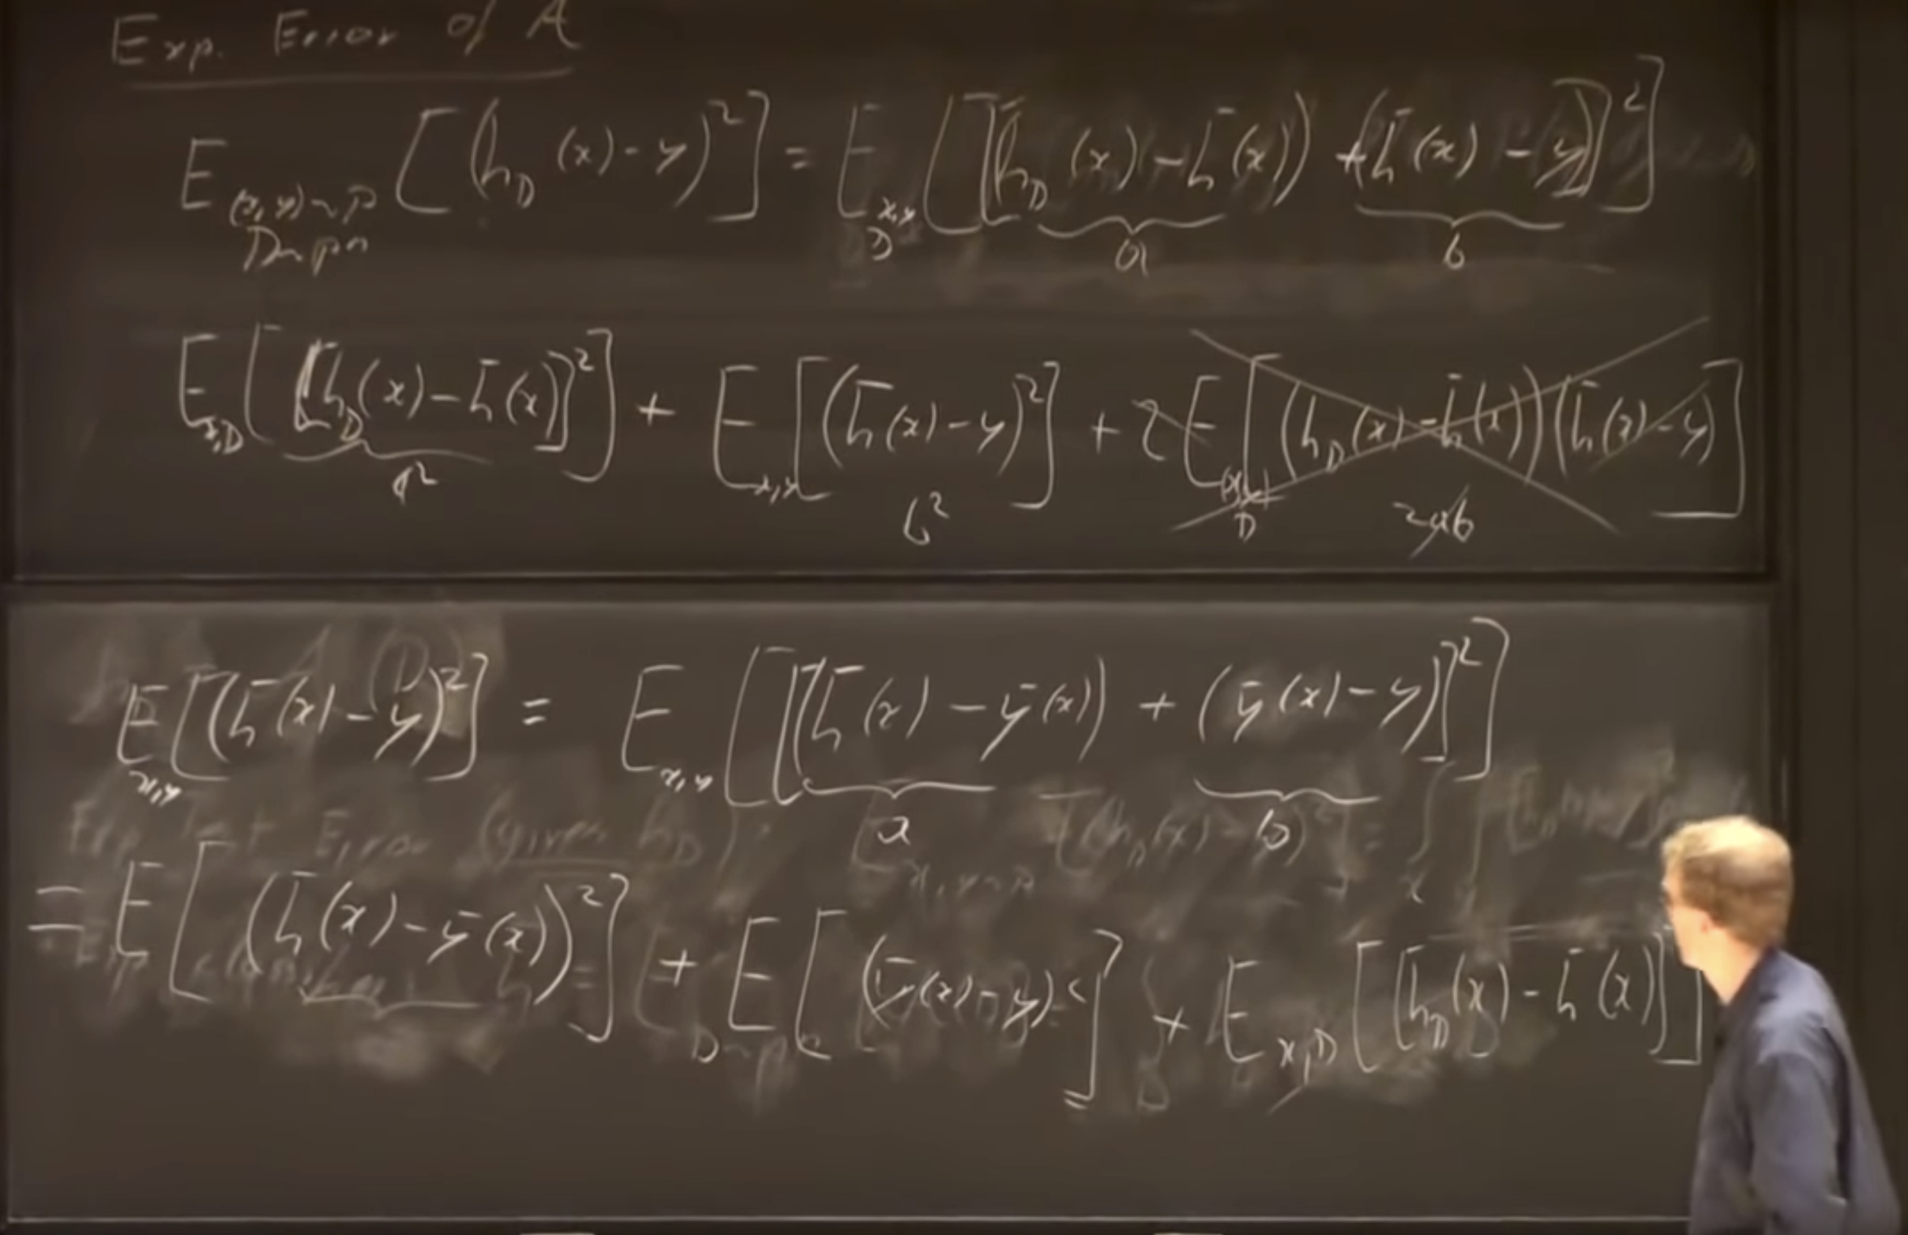
Derivation1 of Bias-Variance Decomposition
Credit by Dr. Kilian Weinberger, Machine Learning, Cornell CS4780 SP17
https://youtu.be/zUJbRO0Wavo?t=2441
http://www.cs.cornell.edu/courses/cs4780/2018fa/lectures/lecturenote12.html

Slide 40
Derivation2 of Bias-Variance Decomposition
https://en.wikipedia.org/wiki/Bias%E2%80%93variance_tradeoff

Slide 41
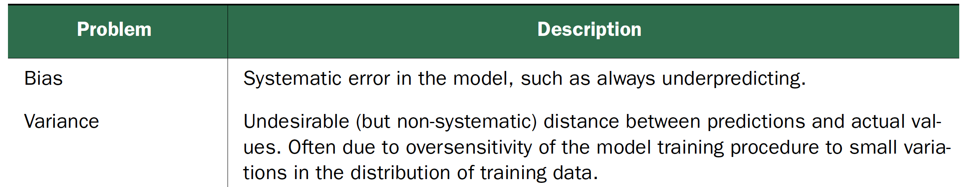
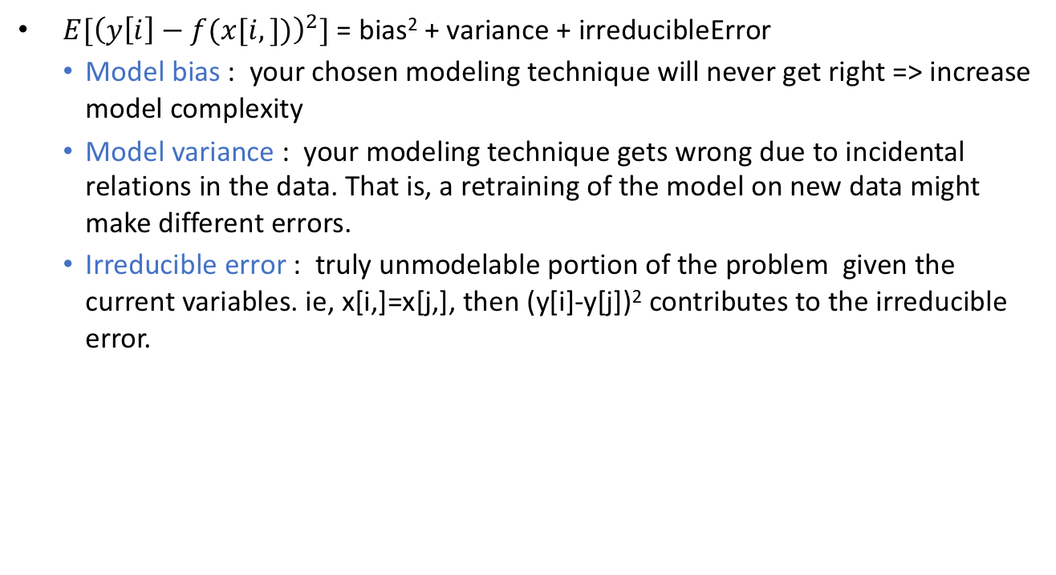
Bias-Variance Decomposition
$E[{\left(y\left[i\right]−f(x[i,])\right)}^{2}]$ = bias² + variance + irreducibleError
Model bias : your chosen modeling technique will never get right => increase model complexity
Model variance : your modeling technique gets wrong due to incidental relations in the data. That is, a retraining of the model on new data might make different errors.
Irreducible error : truly unmodelable portion of the problem given the current variables. ie, x[i,]=x[j,], then (y[i]-y[j])² contributes to the irreducible error.
Practical Data Science with R by Nina Zumel, John Mount

Slide 42
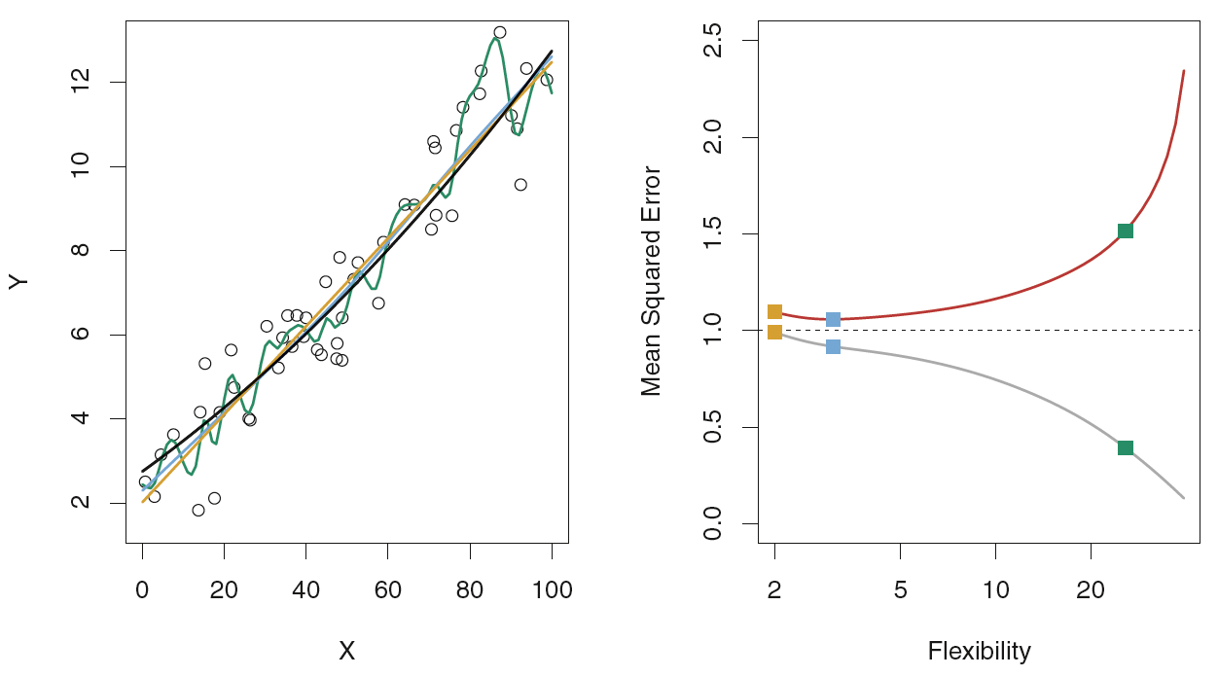
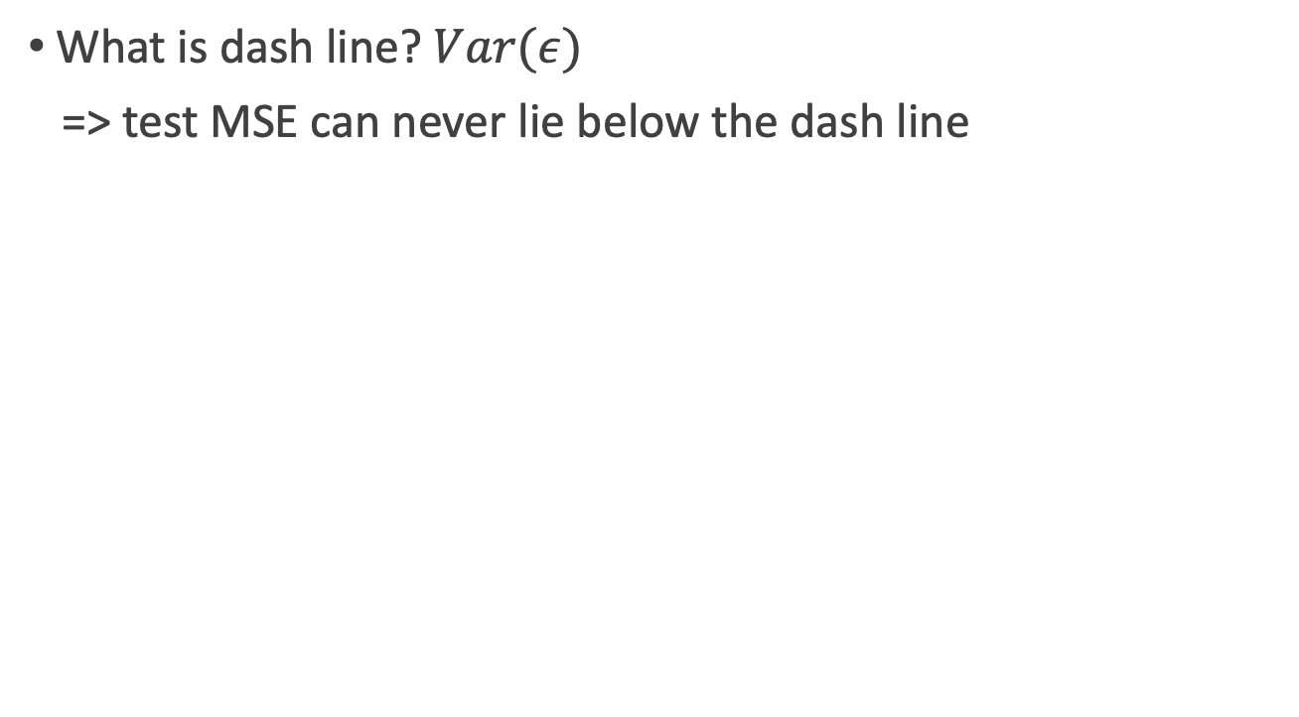
Irreducible error
What is dash line? $Var(ε)$
=> test MSE can never lie below the dash line
Figure2.10, An Introduction to Statistical Learning with Applications in R by Gareth James, Daniela Witten, Trevor Hastie, Robert Tibshirani

Slide 43
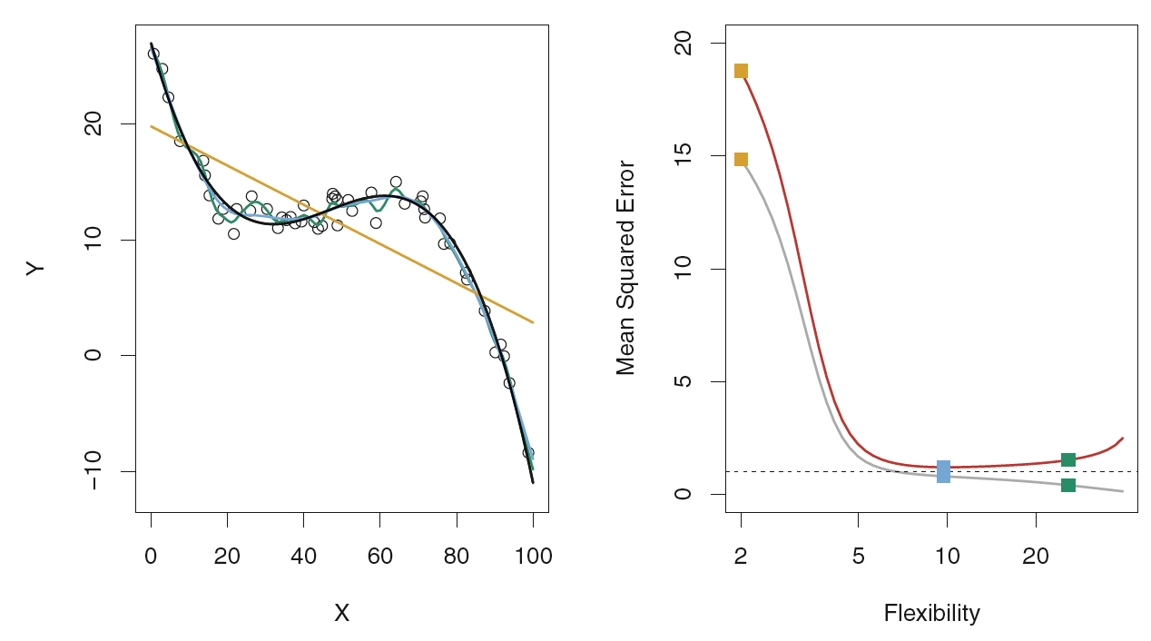
Bias
the error that is introduced by approximating a real-life problem
the true f is substantially non-linear => no matter how many training observations we are given, it will not be possible to produce an accurate estimate using linear regression
=> linear regression results in high bias in this example.
Figure 2.11, An Introduction to Statistical Learning with Applications in R by Gareth James, Daniela Witten, Trevor Hastie, Robert Tibshirani

Slide 44
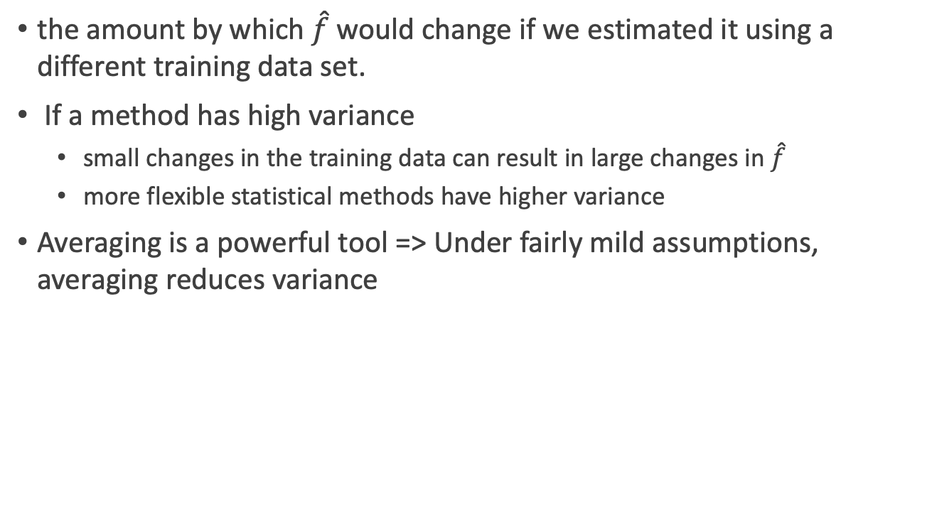
Variance
the amount by which $\hat{f}$would change if we estimated it using a different training data set.
If a method has high variance
small changes in the training data can result in large changes in $\hat{f}$
more flexible statistical methods have higher variance
Averaging is a powerful tool => Under fairly mild assumptions, averaging reduces variance
An Introduction to Statistical Learning with Applications in R by Gareth James, Daniela Witten, Trevor Hastie, Robert Tibshirani

Slide 45
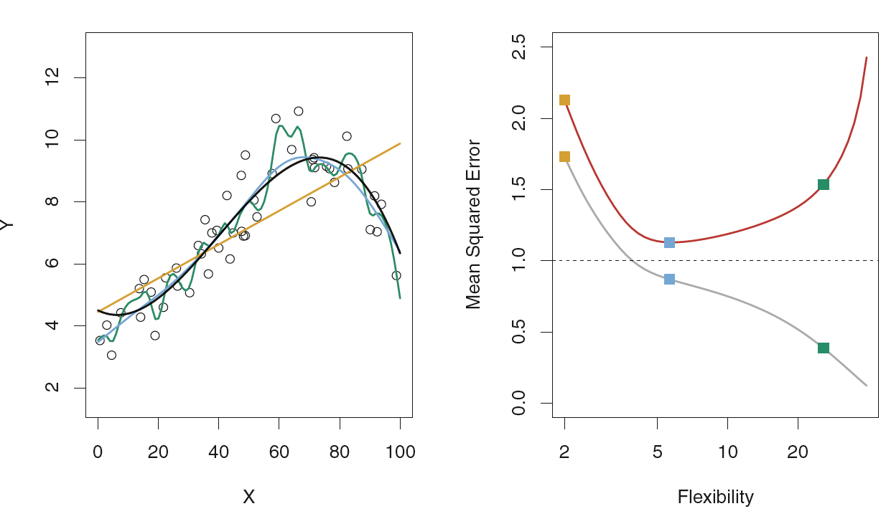
Which method is high variance?
Figure 2.9, An Introduction to Statistical Learning with Applications in R by Gareth James, Daniela Witten, Trevor Hastie, Robert Tibshirani

Slide 46
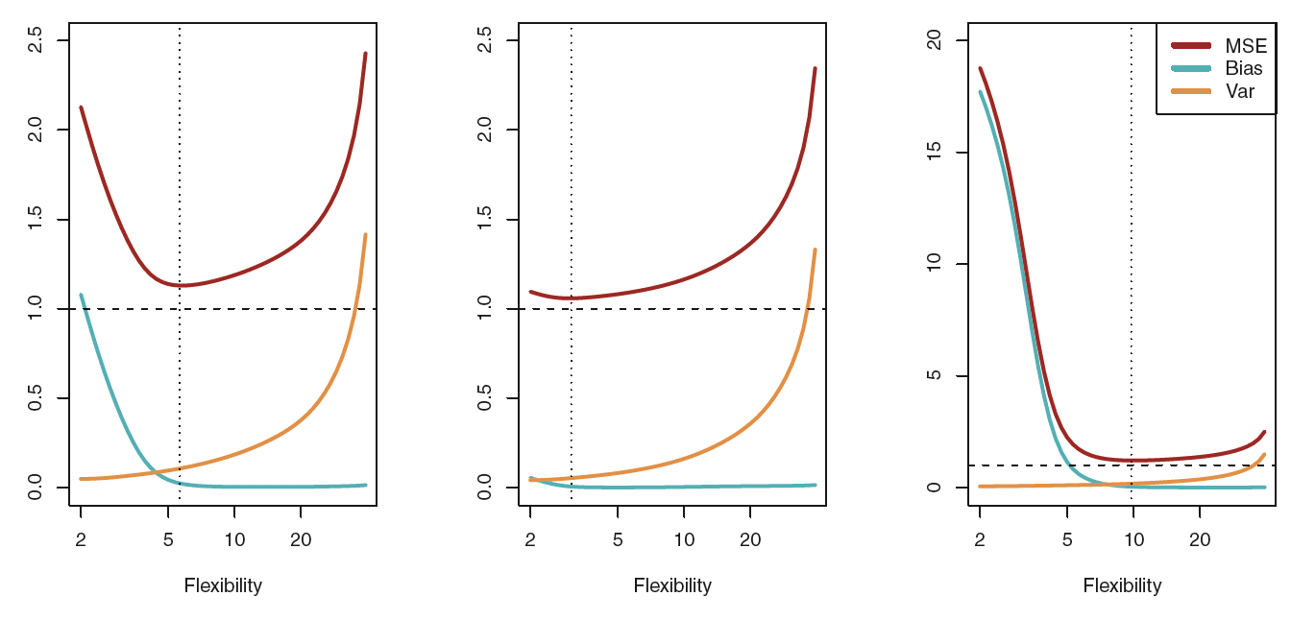
Bias-Variance trade off
a method extremely low bias but high variance
drawing a curve that passes through every single training observation
a method with very low variance but high bias
fitting a horizontal line to the data
Figure 2.12, An Introduction to Statistical Learning with Applications in R by Gareth James, Daniela Witten, Trevor Hastie, Robert Tibshirani

Slide 47
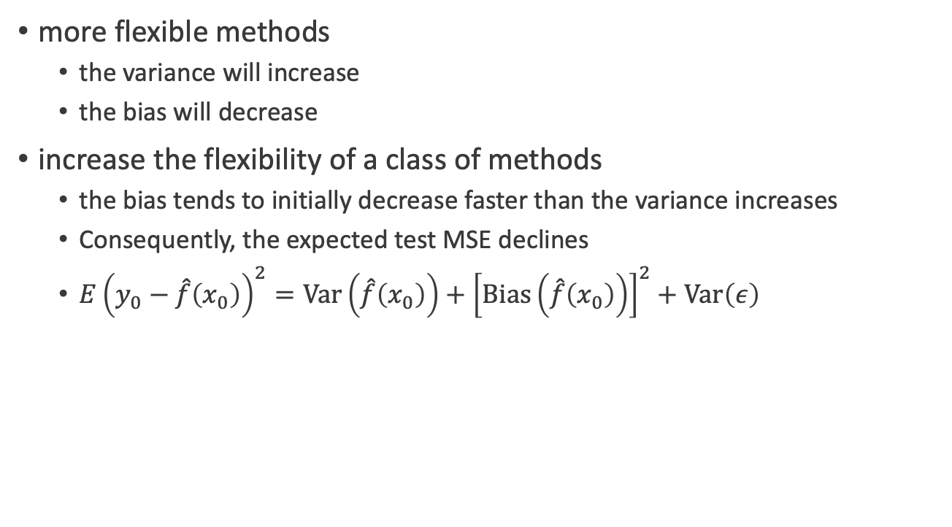
Bias vs. Variance
more flexible methods
the variance will increase
the bias will decrease
increase the flexibility of a class of methods
the bias tends to initially decrease faster than the variance increases
Consequently, the expected test MSE declines
$E{\left(y_{0}−\hat{f}\left(x_{0}\right)\right)}^{2}=\text{Var}\left(\hat{f}\left(x_{0}\right)\right)+{\left[\text{Bias}\left(\hat{f}\left(x_{0}\right)\right)\right]}^{2}+\text{Var}\left(ε\right)$
An Introduction to Statistical Learning with Applications in R by Gareth James, Daniela Witten, Trevor Hastie, Robert Tibshirani

Slide 48
Bias-Variance trade off
increase the flexibility of a class of methods
the bias tends to initially decrease faster than the variance increases
at some point increasing flexibility has little impact on the bias but starts to significantly increase the variance.
Figure 2.12, An Introduction to Statistical Learning with Applications in R by Gareth James, Daniela Witten, Trevor Hastie, Robert Tibshirani

Slide 49
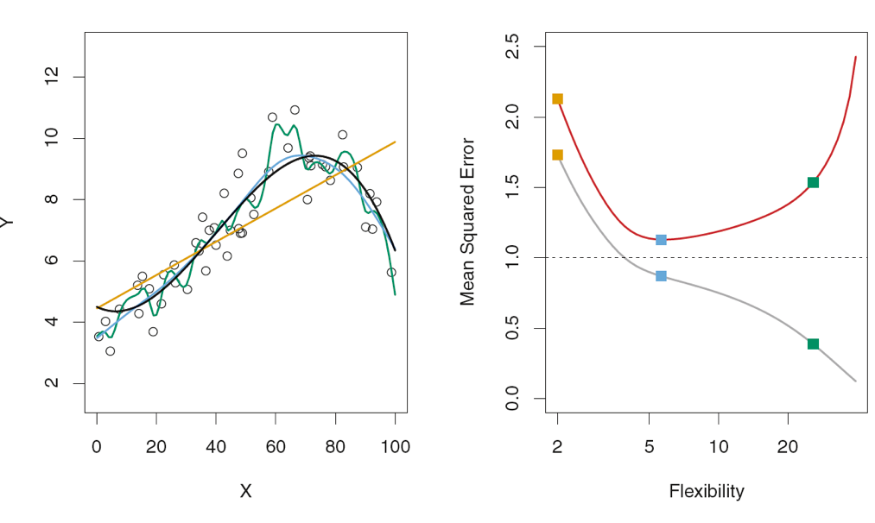
U-shape
Figure 2.9、2.10, An Introduction to Statistical Learning with Applications in R by Gareth James, Daniela Witten, Trevor Hastie, Robert Tibshirani

Slide 50
Bias-Variance trade off
The vertical dotted line indicates the flexibility level corresponding to the smallest test MSE.
Figure 2.12, An Introduction to Statistical Learning with Applications in R by Gareth James, Daniela Witten, Trevor Hastie, Robert Tibshirani

Slide 51
Overfitting

Slide 52
Overfitting
training error : a model’s prediction error on the data that it trained
generalization error : a model’s prediction error on new data
overfit : if generalization error is large => prefer simpler models
Practical Data Science with R by Nina Zumel, John Mount

Slide 53
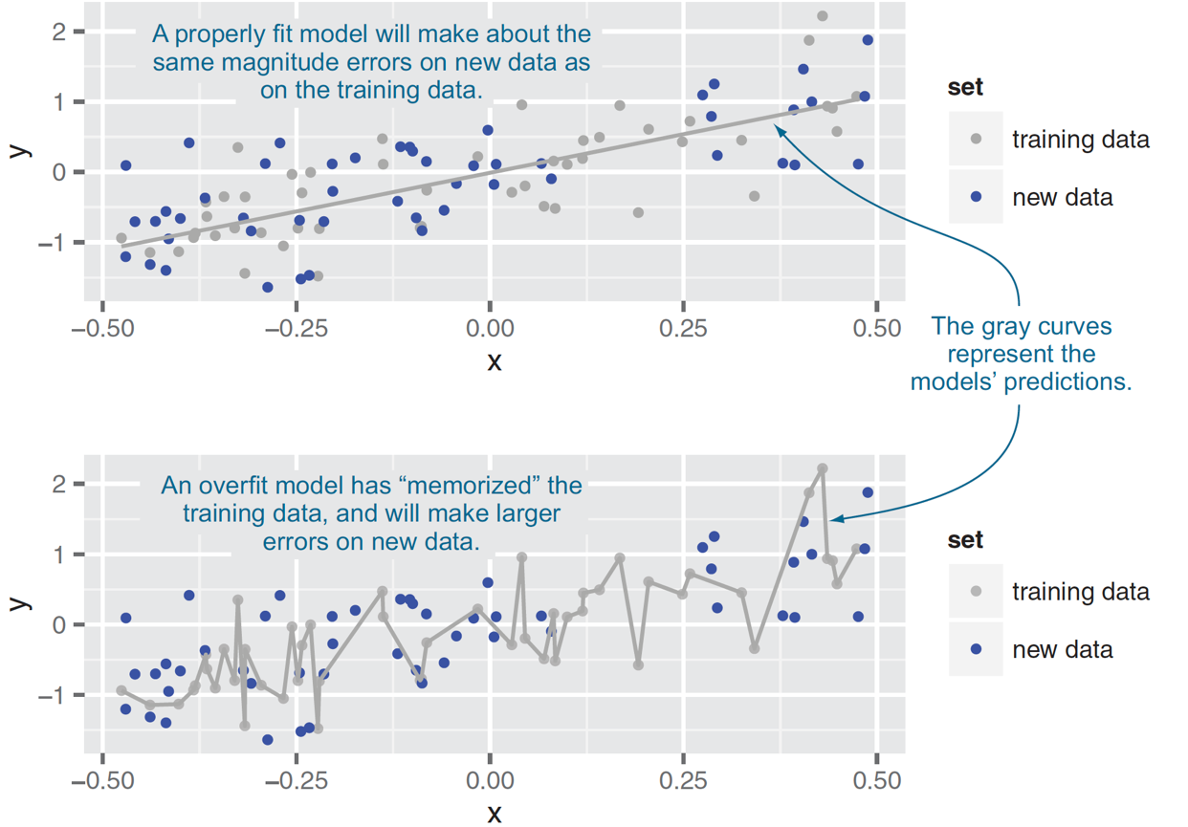
Overfitting
Figure5.11, Practical Data Science with R by Nina Zumel, John Mount

Slide 54
How to check if a model fit is good?
Dr. Thomas Jensen -Expedia.com and Prof. Olga Veksler - CS9840 - Learning and Computer Vision

Slide 55
How to check if a model fit is good?
Dr. Thomas Jensen -Expedia.com and Prof. Olga Veksler - CS9840 - Learning and Computer Vision

Slide 56
Overfitting
Modeling techniques tend to overfit the data.
Multiple regression
Every time you add a variable to the regression, the model’s R² goes up
Naïve interpretation: every additional predictive variable helps to explain yet more of the target’s variance
Left to its own devices, Multiple Regression will fit too many patterns
Dr. Thomas Jensen -Expedia.com and Prof. Olga Veksler - CS9840 - Learning and Computer Vision

Slide 57
Overfitting
Error on the dataset used to fit the model can be misleading
Doesn’t predict future performance.
Too much complexity can diminish model’s accuracy on future data.
Sometimes called the Bias-Variance Tradeoff.
Dr. Thomas Jensen -Expedia.com and Prof. Olga Veksler - CS9840 - Learning and Computer Vision

Slide 58
Overfitting
What are the consequences of overfitting?
“Overfitted models will have high R² values, but will perform poorly in predicting out-of-sample cases”
Dr. Thomas Jensen -Expedia.com and Prof. Olga Veksler - CS9840 - Learning and Computer Vision

Slide 59
Three-way cross-validation

Slide 60
Ensuring model quality
Testing On Held-out Data
K-fold cross-validation
the related ideas of empirical resampling and bootstrapping
Practical Data Science with R by Nina Zumel, John Mount

Slide 61
Ensuring model quality
Split
a subset of the training data is used to build a model
a complementary subset of the training data is used to score the model
repeated cross-validation, replicated cross-validation
Practical Data Science with R by Nina Zumel, John Mount

Slide 62
Cross-validation
In cross-validation the original sample is split into two parts.
One part is called the training (or derivation) sample
the other part is called the validation (testing) sample.
Dr. Thomas Jensen -Expedia.com and Prof. Olga Veksler - CS9840 - Learning and Computer Vision

Slide 63
How should the sample be split?
The most common approach is to divide the sample randomly, thus theoretically eliminating any systematic differences.
Modeling of the data uses one part only. The model selected for this part is then used to predict the values in the other part of the data. A valid model should show good predictive accuracy.
R ² offers no protection against is overfitting. On the other hand, cross validation, by allowing us to have cases in our testing set that are different from the cases in our training set, inherently offers protection against overfitting.
Dr. Thomas Jensen -Expedia.com and Prof. Olga Veksler - CS9840 - Learning and Computer Vision

Slide 64
K-fold Cross Validation
Since data are often scarce, there might not be enough to set aside for a validation sample
To work around this issue k-fold CV works as follows:
Split the sample into k subsets of equal size
For each fold estimate a model on all the subsets except one
Use the left out subset to test the model, by calculating a CV metric of choice
Average the CV metric across subsets to get the CV error
This has the advantage of using all data for estimating the model, however finding a good value for k can be tricky.
Dr. Thomas Jensen -Expedia.com and Prof. Olga Veksler - CS9840 - Learning and Computer Vision

Slide 65
5-fold Cross Validation Example
Split the data into 5 samples
Fit a model to the training samples and use the test sample to calculate a CV metric.
Repeat the process for the next sample, until all samples have been used to either train or test the model
Dr. Thomas Jensen -Expedia.com and Prof. Olga Veksler - CS9840 - Learning and Computer Vision

Slide 66
Training/test Data Split
What about test error? Seems appropriate
degree 2 is the best model according to the test error
Except what do we report as the test error now?
Test error should be computed on data that was not used for training at all
Here used “test” data for training, i.e. choosing model
Dr. Thomas Jensen -Expedia.com and Prof. Olga Veksler - CS9840 - Learning and Computer Vision

Slide 67
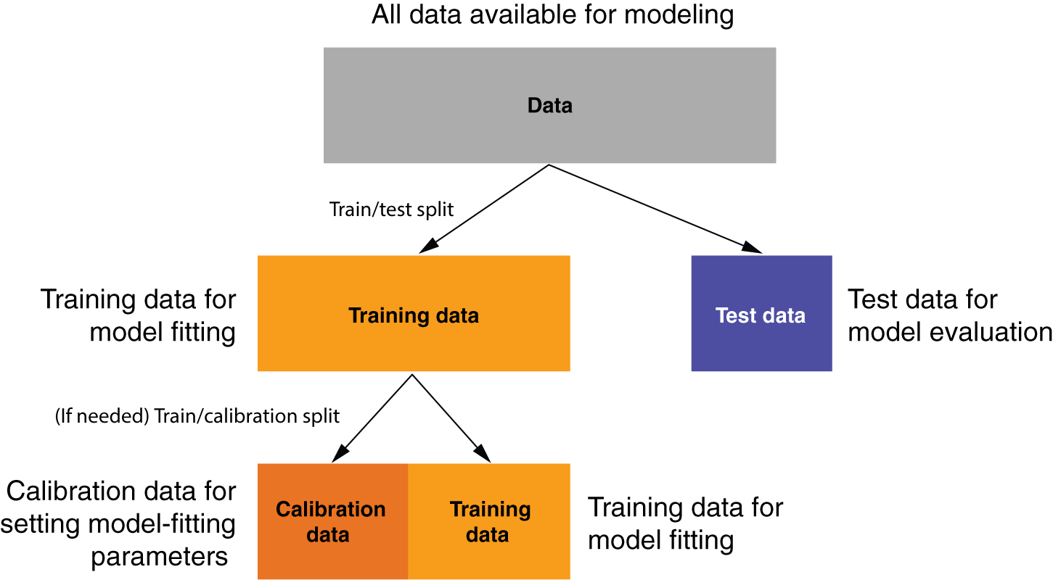
Splitting data into training, calibration, and test sets
Figure 4.12, Practical Data Science with R (sec.) by Nina Zumel, John Mount

Slide 68
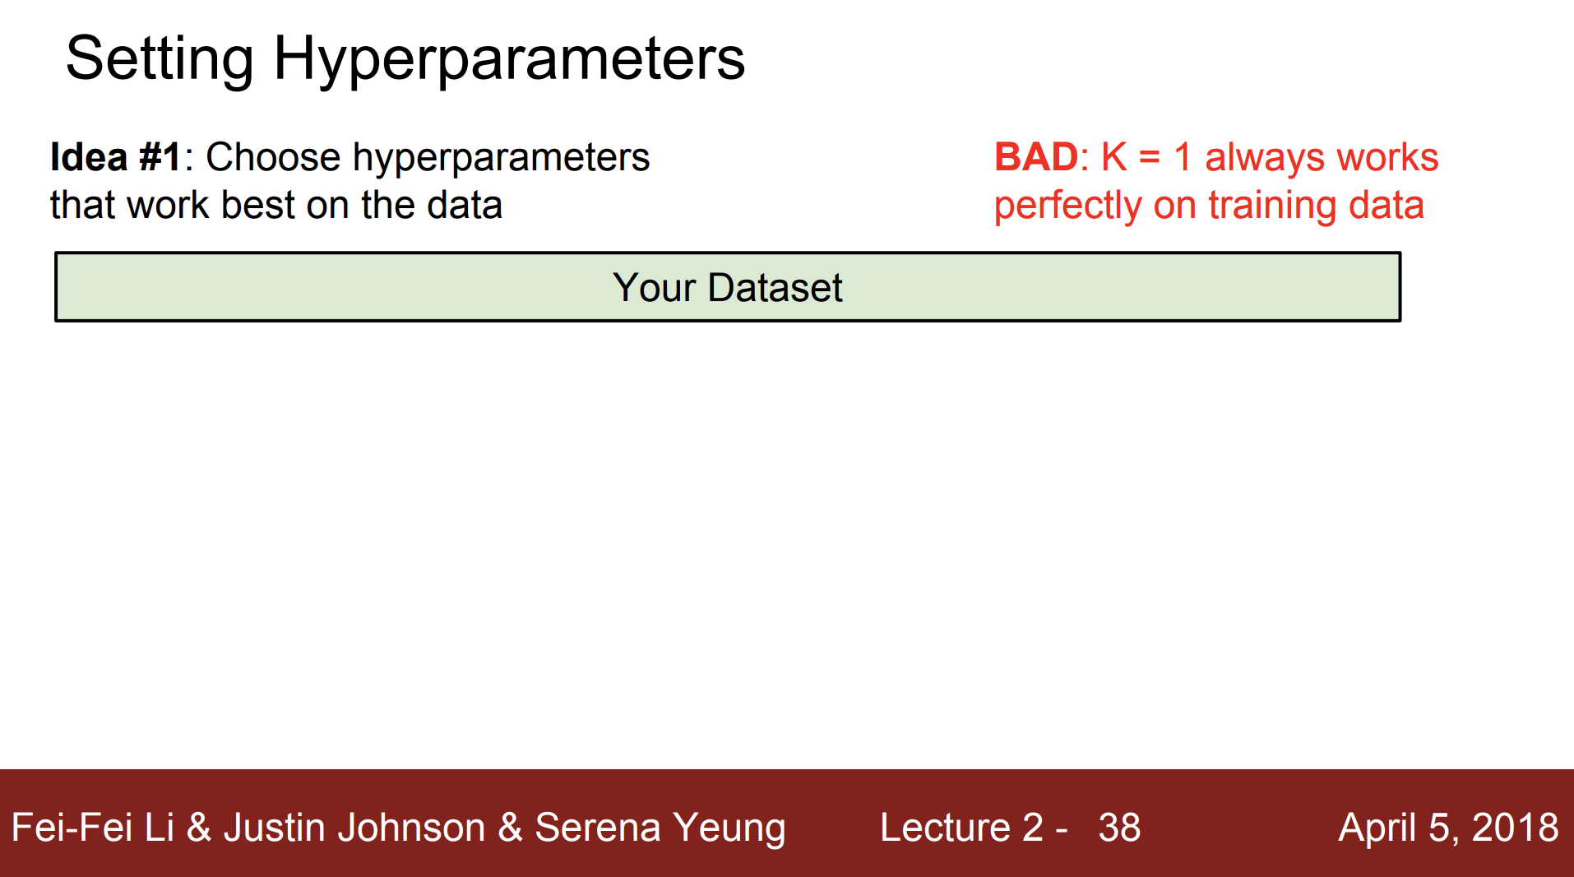

Slide 69
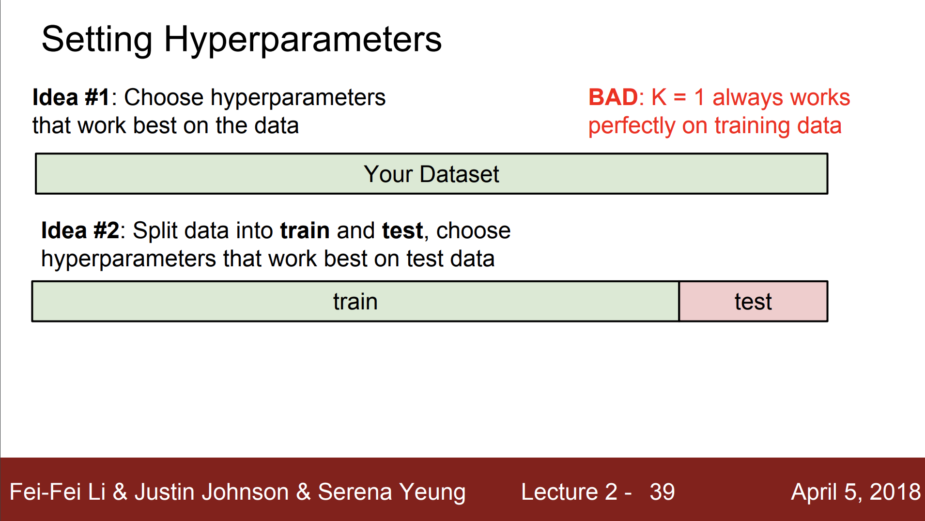

Slide 70
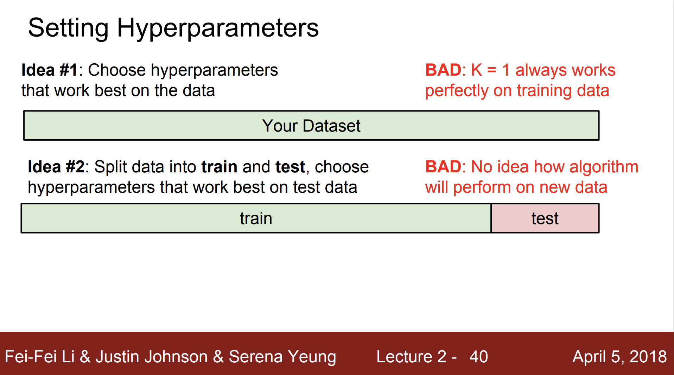

Slide 71
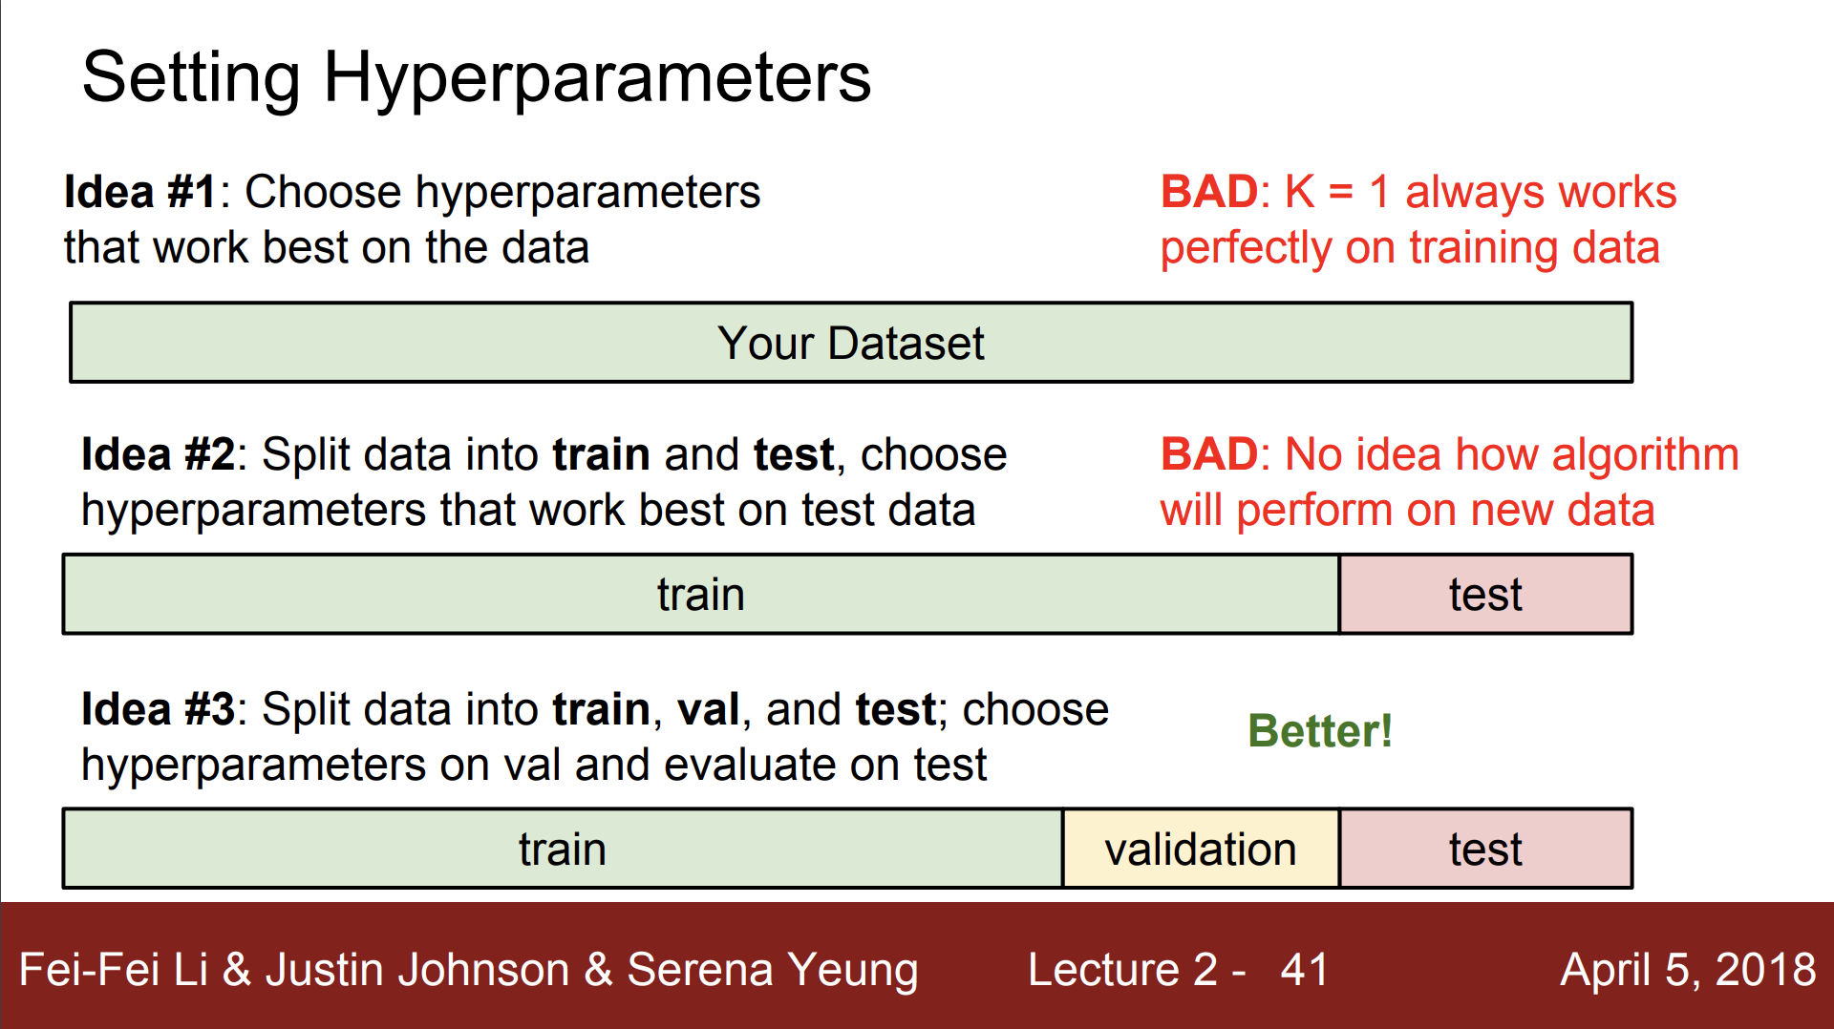

Slide 72
Why three-way data split?
data leakage Importantly, any data preparation prior to fitting the model or tuning of the hyperparameter of the model must occur within the for-loop on the data sample. This is to avoid data leakage where knowledge of the test dataset is used to improve the model. This, in turn, can result in an optimistic estimate of the model skill.
Ideally, the test set should be kept in a “vault,” and be brought out only at the end of the data analysis. Suppose instead that we use the test-set repeatedly, choosing the model with smallest test-set error. Then the test set error of the final chosen model will underestimate the true test error, sometimes substantially.
Credit by The Elements of Statistical Learning Trevor Hastie, Robert Tibshirani, Jerome Friedman,

Slide 73
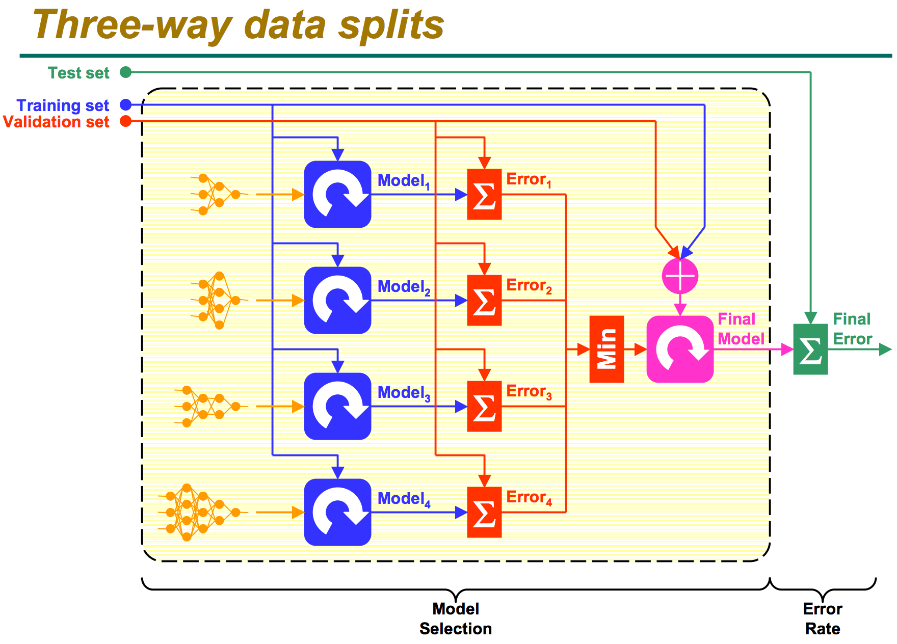
http://research.cs.tamu.edu/prism/lectures/iss/iss_l13.pdf

Slide 74
Validation Data
Same question when choosing among several classifiers
our polynomial degree example can be looked at as choosing among 3 classifiers (degree 1, 2, or 3)
Solution: split the labeled data into three parts
Dr. Thomas Jensen -Expedia.com and Prof. Olga Veksler - CS9840 - Learning and Computer Vision

Slide 75
Three-way data split
In cross-validation the original sample is split into two parts.
One part is called the training (or derivation) sample
the other part is called the validation (or validation + testing) sample.
The training set : to fit the models
The validation set : to estimate prediction error for model selection
The test set : for assessment of the generalization error of the final chosen model
Credit by The Elements of Statistical Learning Trevor Hastie, Robert Tibshirani, Jerome Friedman

Slide 76
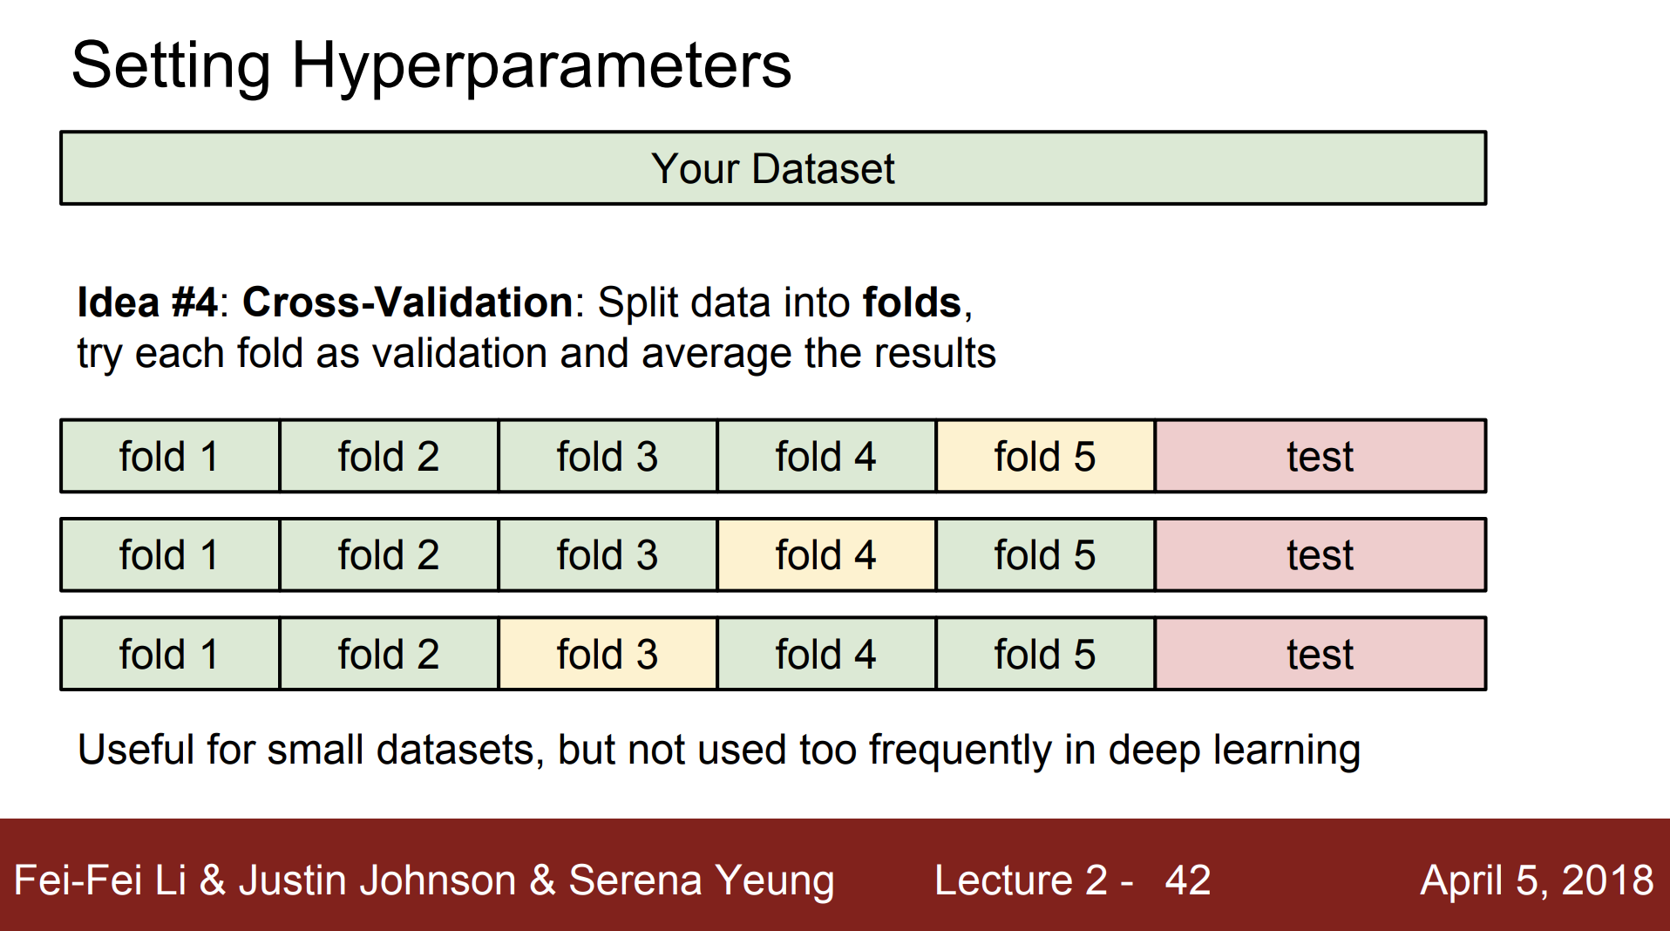

Slide 77
Training/Validation/Test Data
Training Data
Validation Data
d = 2 is chosen
Test Data
1.3 test error computed for d = 2
Dr. Thomas Jensen -Expedia.com and Prof. Olga Veksler - CS9840 - Learning and Computer Vision

Slide 78
What portion of the sample should be in each part?
If sample size is very large, it is often best to split the sample in half.
For smaller samples, it is more conventional to split the sample such that 2/3 of the observations are in the derivation sample and 1/3 are in the validation sample.
Dr. Thomas Jensen -Expedia.com and Prof. Olga Veksler - CS9840 - Learning and Computer Vision

Slide 79
LOOCV (Leave-One-Out Cross Validation)
For k=1 to n
Let (x^{k},y^{k}) be the k example
Dr. Thomas Jensen -Expedia.com and Prof. Olga Veksler - CS9840 - Learning and Computer Vision

Slide 80
LOOCV
Dr. Thomas Jensen -Expedia.com and Prof. Olga Veksler - CS9840 - Learning and Computer Vision

Slide 81
LOOCV
Dr. Thomas Jensen -Expedia.com and Prof. Olga Veksler - CS9840 - Learning and Computer Vision

Slide 82
LOOCV
Dr. Thomas Jensen -Expedia.com and Prof. Olga Veksler - CS9840 - Learning and Computer Vision

Slide 83
LOOCV
Dr. Thomas Jensen -Expedia.com and Prof. Olga Veksler - CS9840 - Learning and Computer Vision

Slide 84
LOOCV
Dr. Thomas Jensen -Expedia.com and Prof. Olga Veksler - CS9840 - Learning and Computer Vision

Slide 85
LOOCV for Quadratic Regression
Dr. Thomas Jensen -Expedia.com and Prof. Olga Veksler - CS9840 - Learning and Computer Vision

Slide 86
LOOCV for Join The Dots
Dr. Thomas Jensen -Expedia.com and Prof. Olga Veksler - CS9840 - Learning and Computer Vision

Slide 87
Which kind of Cross Validation?
Dr. Thomas Jensen -Expedia.com and Prof. Olga Veksler - CS9840 - Learning and Computer Vision

Slide 88
Improve cross-validation
Even better: repeated cross-validation
Example:
10-fold cross-validation is repeated 10 times and results are averaged (reduce the variance)
Dr. Thomas Jensen -Expedia.com and Prof. Olga Veksler - CS9840 - Learning and Computer Vision

Slide 89
Best Practice for Reporting Model Fit
Use Cross Validation to find the best model
Report the RMSE and MAPE statistics from the cross validation procedure
Report the R² from the model as you normally would.
The added cross-validation information will allow one to evaluate not how much variance can be explained by the model, but also the predictive accuracy of the model. Good models should have a high predictive AND explanatory power!
Dr. Thomas Jensen -Expedia.com and Prof. Olga Veksler - CS9840 - Learning and Computer Vision

Slide 90
Sampling for modeling and validation
train/calibration, test
Splitting into test and training using a random group mark
custdata$gp <- runif(dim(custdata)[1])
testSet <- subset(custdata, custdata$gp <= 0.1)
trainingSet <- subset(custdata, custdata$gp > 0.1)
testSet <- subset(custdata, custdata$gp <= 0.2)
trainingSet <- subset(custdata, custdata$gp > 0.2)
Practical Data Science with R by Nina Zumel, John Mount

Slide 91
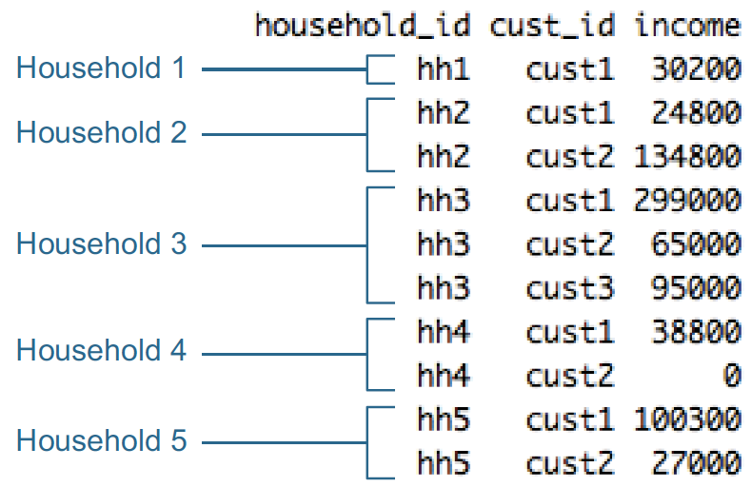
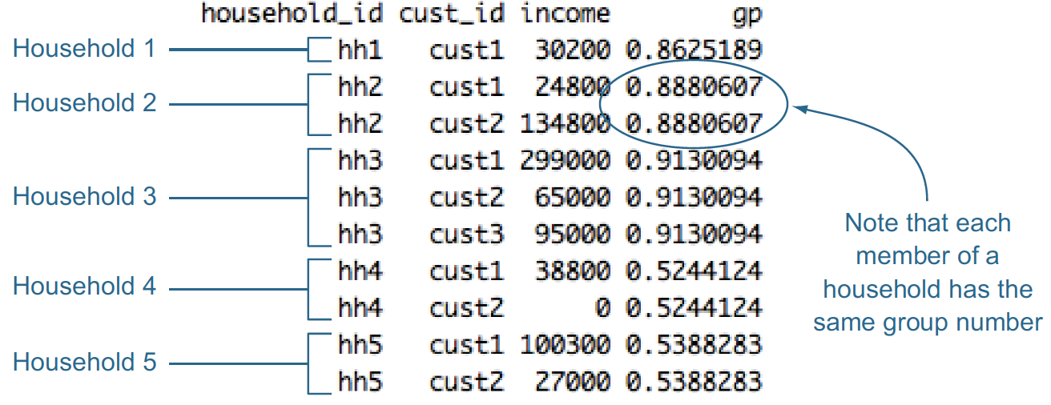
Record grouping
hh <- unique(hhdata$household_id)
households <- data.frame(household_id = hh, gp = runif(length(hh)))
hhdata <- merge(hhdata, households, by="household_id")
Practical Data Science with R by Nina Zumel, John Mount

Slide 92
Lower bound v.s. Upper bound

Slide 93
Model evaluation and critique
To decide if a given score is high or low
a null model : tells us what low performance looks like
best single-variable model : tells us what a simple model can achieve
a Bayes rate model : tells us what high performance looks like
Practical Data Science with R by Nina Zumel, John Mount

Slide 94
Determining lower bounds on model performance
NULL MODEL - as being “the obvious guess”
single constant (returns the same answer for all situations)
independent (doesn’t record any important relation or interaction between inputs and outputs)
Practical Data Science with R by Nina Zumel, John Mount

Slide 95
How to build a null model?
Common way
a categorical problem => always return the most popular Category
A model that labels all loans as GoodLoan => 70% accurate
a score model => often the average of all the outcomes
Practical Data Science with R by Nina Zumel, John Mount

Slide 96
Where to find null models?
Independent
Permutation test
permute the input (or independent) variables among examples
there’s no real relation between the modeling features (which we have permuted among examples) and the quantity to be predicted
X_{1,1} X_{1,2} … X_{1,p} Y₁
X_{2,1} X_{2,2} … X_{2,p} Y₂
…
X_{n,1} X_{n,2} … X_{n,p} Y_{n}
X_{n,1} X_{n,2} … X_{n,p} Y₁
X_{3,1} X_{3,2} … X_{3,p} Y₂
…
X_{2,1} X_{2,2} … X_{2,p} Y_{n}
permutation

Slide 97
Single-variable models
We also suggest comparing any complicated model against the best single-variable model you have available
Practical Data Science with R by Nina Zumel, John Mount

Slide 98
Determining upper bounds on model performance
Bayes Rate Model (also saturated model)
only makes mistakes when there are multiple examples with the exact same set of known facts (same xs) but different outcomes (different ys)
unexplainable variance: how much of the variation in your output can’t be explained by your input variables.
i.e., loans that equal more than 15% of the borrower’s disposable income will default; otherwise, loans are good.
Practical Data Science with R by Nina Zumel, John Mount

Slide 99
Determining upper bounds on model performance
Bayes rate : The limit on prediction accuracy due to unexplainable variance.
=> You can think of the Bayes rate as describing the best accuracy you can achieve given your data.
Practical Data Science with R by Nina Zumel, John Mount

Slide 100
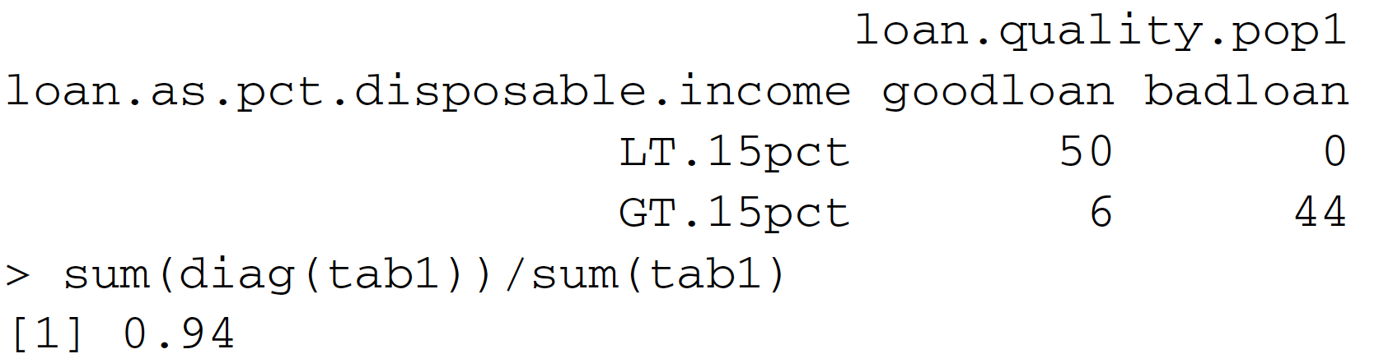
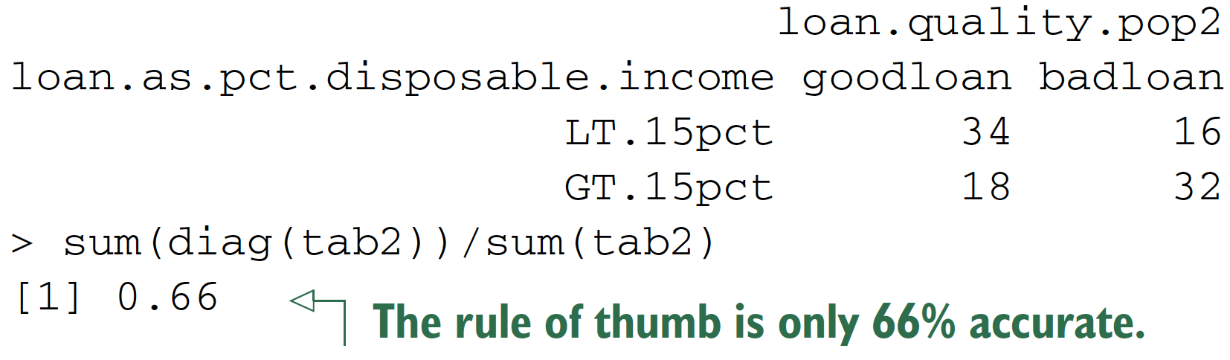
Determining upper bounds on model performance
Bayes rate : The limit on prediction accuracy due to unexplainable variance.
=> You can think of the Bayes rate as describing the best accuracy you can achieve given your data.
Practical Data Science with R by Nina Zumel, John Mount

Slide 101
Null model, p-value

Slide 102
You model v.s. Null model
your model should out-perform the null model
73% > 70% significantly better?
Practical Data Science with R by Nina Zumel, John Mount​

Slide 103
Significance testing
if it’s very unlikely that a naive model could score as well as our model!!!
Example:
you’ve trained a model to predict how much a house will sell for, based on certain variables
null model : the average selling price of a house in the neighborhood
Mispredict given house’s selling price
err.model from you
err.null from null model
Practical Data Science with R by Nina Zumel, John Mount​

Slide 104
Significance testing
null hypothesis D = (err.null - err.model) == 0
p-value is the probability of null hypothesis
p < 0.05 => reject the null hypothesis
Student’s t-test, an f-test, fisher.test() (for the confusion matrix)
Practical Data Science with R by Nina Zumel, John Mount​

Slide 105
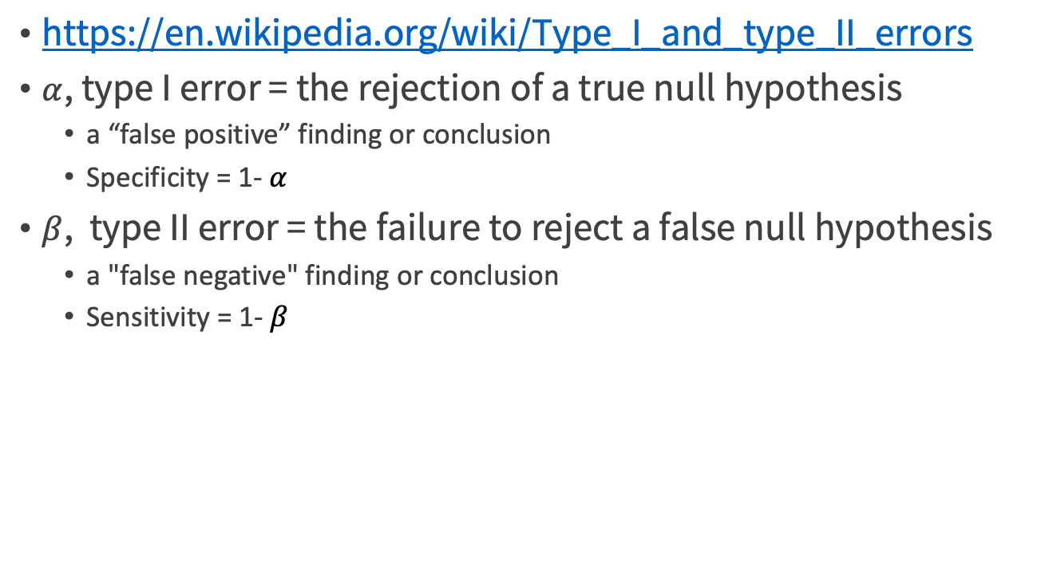
Type I & Type II error
https://en.wikipedia.org/wiki/Type_I_and_type_II_errors
$α$, type I error = the rejection of a true null hypothesis
a “false positive” finding or conclusion
Specificity = 1- $α$
$β$, type II error = the failure to reject a false null hypothesis
a "false negative" finding or conclusion
Sensitivity = 1- $β$

Slide 106
A/B test

Slide 107

Credit by 謝宗震 智庫驅動

Slide 108
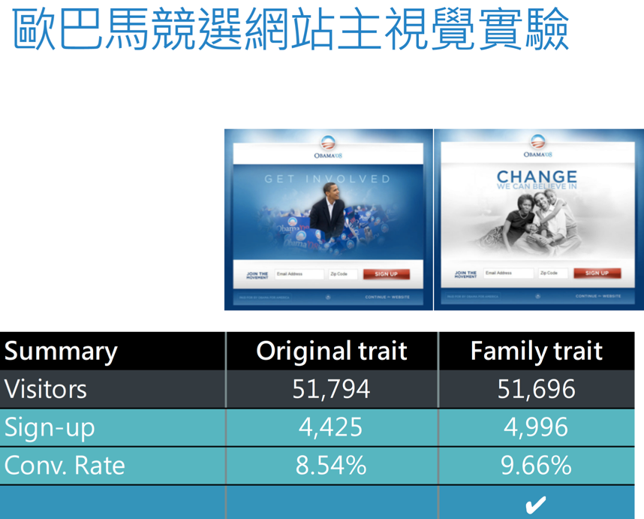
Credit by 謝宗震 智庫驅動

Slide 109
A/B tests
Hard statistical problems usually arise from poor experimental design.
A (control) / B(treatment) testing:
Each group is big enough that you get a reliable measurement (this drives significance).
Each group is (up to a single factor) distributed exactly like populations you expect in the future (this drives relevance). In particular, both samples are run in parallel at the same time.
The two groups differ only with respect to the single factor you’re trying to test.

Slide 110
Evaluating A/B tests
evalABtest.R
Building simulated A/B test data
set.seed(123515)
d <- rbind(
data.frame(group='A',converted=rbinom(100000,size=1,p=0.05)),
data.frame(group='B',converted=rbinom(10000,size=1,p=0.055))
)
Summarizing the A/B test into a contingency table
tab <- table(d)
print(tab)
Practical Data Science with R by Nina Zumel, John Mount

Slide 111
The contingency table
AKA
a cross tabulation
a crosstab
a table showing the distribution of one variable in rows and another in columns, used to study the association between the two variable.
converted
group 0 1
A 94979 5021
B 9398 602

Slide 112
Chi-squared test

Slide 113
Chi-squared/Fisher’s exact test
assess for independence between two variables when the comparing groups are independent and not correlated
chi-squared test : apply an approximation assuming the sample is large
Fisher's exact test : runs an exact procedure especially for small-sized samples
Credit by Hae-Young Kim, Statistical notes for clinical researchers: Chi-squared test and Fisher's exact test

Slide 114
Chi-squared test
used to compare the distribution of a categorical variable in a sample or a group with the distribution in another one.
If the distribution of the categorical variable is not much different over different groups, we can conclude the distribution of the categorical variable is not related to the variable of groups.
Credit by Hae-Young Kim, Statistical notes for clinical researchers: Chi-squared test and Fisher's exact test

Slide 115
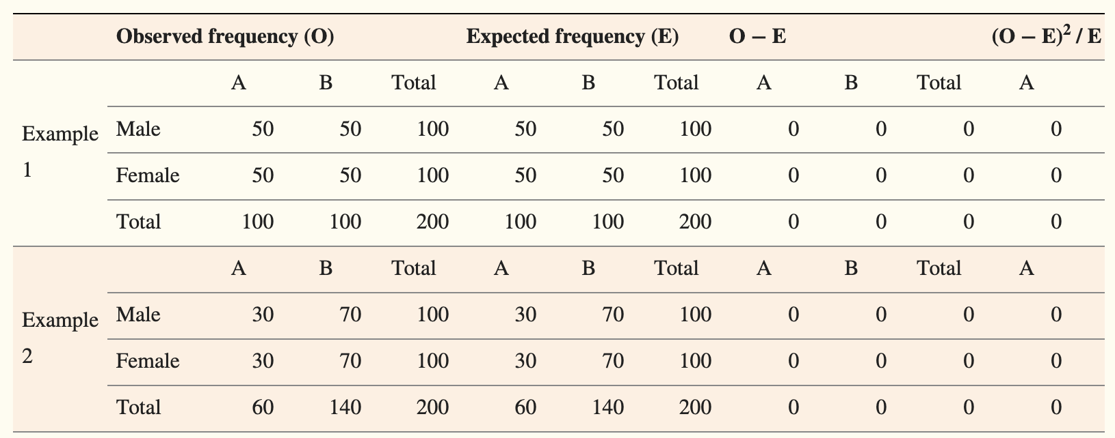
Chi-squared test example 1&2
condition (A and B) v.s. gender (male and female)
there is equal chance of having the condition among men and women, we will find the chance of observing the condition is the same regardless of gender and can conclude their relationship as independent.
Contingency tables and procedure for Chi-squared test
Credit by Hae-Young Kim, Statistical notes for clinical researchers: Chi-squared test and Fisher's exact test

Slide 116
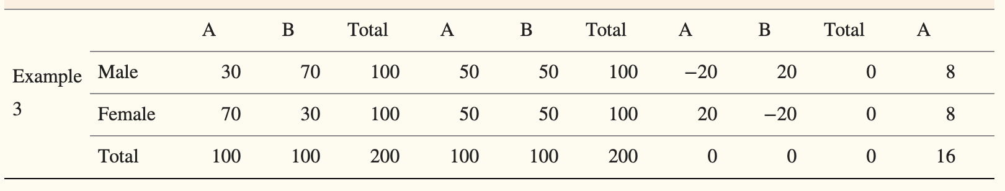
Chi-squared test example 3
condition (A and B) v.s. gender (male and female)
women had a greater chance to have the condition A (p = 0.7) compared to men (p = 0.3)
men have a specific condition more than women, there is bigger chance to find a person with the condition among men than among women.
gender is NOT independent from the condition
Credit by Hae-Young Kim, Statistical notes for clinical researchers: Chi-squared test and Fisher's exact test

Slide 117

The test statistic of chi-squared test
$χ^{2}=\sum{\frac{{\left(O−E\right)}^{2}}{E}\sim }χ^{2}$ with degrees of freedom (r - 1)(c - 1), where
O : observed frequency
E : expected frequency
r : the number of rows of the contingency table
c : the number of columns of the contingency table
Credit by Hae-Young Kim, Statistical notes for clinical researchers: Chi-squared test and Fisher's exact test

Slide 118
the Degrees of Freedom (DF)
the maximum number of logically independent values, which are values that have the freedom to vary, in the data sample.
if the variance is to be estimated from a random sample of N independent scores, then the degrees of freedom =
the number of independent scores (N) minus the number of parameters estimated as intermediate steps (one, namely, the sample mean)
N − 1.
Example
The values of the five integers must have an average of six.
If four of the items {3, 8, 5, and 4}, the fifth number must be 10.
Because the first four numbers can be chosen at random, the degrees of freedom is four.
Credit by https://www.investopedia.com/terms/d/degrees-of-freedom.asp

Slide 119


The chi-squared test of examples
For the ‘male and A’ cell in example 3
$\frac{{\left(O−E\right)}^{2}}{E}=\frac{{\left(30−50\right)}^{2}}{50}=8$
Chi-squared statistic calculate
Example 1 & 2 : 0
Example 3 : $\sum{\frac{{\left(O−E\right)}^{2}}{E}=8+8+8+8=32}$
Credit by Hae-Young Kim, Statistical notes for clinical researchers: Chi-squared test and Fisher's exact test

Slide 120



The chi-squared distribution
If Z₁, ..., Z_{k} are independent, standard normal random variables, then the sum of their squares is distributed according to the chi-squared distribution with k degrees of freedom
$$Q=\sum_{i=1}^{k}{Z_{i}^{2}}$$
Usually denoted as $Q\sim χ^{2}\left(k\right)$ or $Q\sim χ_{k}^{2}$
Credit by https://en.wikipedia.org/wiki/Chi-squared_distribution

Slide 121
The chi-squared distribution
At an alpha level of 0.05 (Type I error, FP)
DF = 1, critical value = ?
qchisq(0.95, df = 1)
Credit by Hae-Young Kim, Statistical notes for clinical researchers: Chi-squared test and Fisher's exact test

Slide 122
Make conclusion referring to the chi-squared distribution
The null hypothesis, H0: independent (no association)
Example 3
The degrees of freedom (DF) = 1
the data has two rows and two columns: (r - 1) * (c - 1) = (2 - 1) * (2 - 1) = 1
a large chi-squared statistic of 32 > 3.84
large enough to reject the null hypothesis of independence => conclude a significant association between two variables.
Credit by Hae-Young Kim, Statistical notes for clinical researchers: Chi-squared test and Fisher's exact test

Slide 123

Another example for chi-square test
chiSquare_example.R
warpbreaks data set from the textile industry
breaks : the number of times there was a break in a warp thread
wool ∈ {𝐴,𝐵} : the type of wool that was tested
tension ∈ {𝐿,𝑀,𝐻} : the tension that was applied to the thread (either low, medium, or high)
We would like to identify whether one type of wool outperforms the other for different levels of tensions.
Credit by Data Science blog, https://www.datascienceblog.net/post/statistical_test/contingency_table_tests/

Slide 124
Fisher’s exact test

Slide 125
Fisher’s test for independence
the null hypothesis : conversion is independent of group => A=B
fisher.test(tab)
How to interpreter?
odds ratio or clinical significance
1.2 => 20% relative improvement in conversion rate between the A and B groups
Practical Data Science with R by Nina Zumel, John Mount

Slide 126
Evaluating A/B tests
observed A and B rates?
(aConversionRate <- tab['A','1']/sum(tab['A',]))
(bConversionRate <- tab['B','1']/sum(tab['B',]))
(commonRate <- sum(tab[,'1'])/sum(tab))
Could such a difference be likely for this sample size due to mere chance and measurement noise?
Practical Data Science with R by Nina Zumel, John Mount

Slide 127
Frequentist significance test
assume that A and B come from an identical distribution with a common conversion rate
=> how likely it would be that the B group scores as high as it did by mere chance!
print(pbinom(
lower.tail=F,
q=tab['B','1']-1,
size=sum(tab['B',]),
prob=commonRate
))
Practical Data Science with R by Nina Zumel, John Mount

Slide 128
Statistical test power
probability of rejecting the null hypothesis when the null hypothesis is false
= 1 - p-value
a travel site that has 6,000 unique visitors per day and a 4% conversion rate from page views to purchase enquiries
test a new design B for the site
Practical Data Science with R by Nina Zumel, John Mount

Slide 129

Statistical test power
seeing a B conversion rate in the range of 4.1 ~ 4.9% if the true B conversion rate were in fact 4.5% => how many customers to the B treatment?
Practical Data Science with R by Nina Zumel, John Mount

Slide 130

Sample size estimate
Size = $\left\lceil \frac{−log\left(errorProb\right)∗targetRate}{{difference}^{2}}\right\rceil$
sampleSize.R
estimate <- function(targetRate,difference,errorProb) {
ceiling(-log(errorProb)*targetRate/(difference^2))
}
(est <- estimate(0.045,0.004,0.05))
We need about 8,426 visitors to have a 95% chance of observing a B conversion rate of at least 0.041 if the true unknown B conversion rate is at least 0.045.
Practical Data Science with R by Nina Zumel, John Mount

Slide 131
Design experiments
ceiling(-log(errorProb)*targetRate/(difference^2))
Sample size
Confidence
Difference
Practical Data Science with R by Nina Zumel, John Mount

Slide 132

Design experiments
Performance difference vs confidence
measure large performance differences with high confidence
measure small performance differences with even moderate confidence.
Practical Data Science with R by Nina Zumel, John Mount

Slide 133
Design experiments
estimate <- function(targetRate,difference,errorProb)
estimate(0.045,0.004,0.05)
Performance difference vs confidence
measure large performance differences with high confidence
estimate(0.045,0.005,0.04)
measure small performance differences with even moderate confidence.
estimate(0.045,0.003,0.06)
Practical Data Science with R by Nina Zumel, John Mount

Slide 134
Exact binomial sample size calculation
We need about 8,426 visitors to have a 95% chance of observing a B conversion rate of at least 0.041 if the true unknown B conversion rate is at least 0.045.
pbinom(ceiling(0.041* 8426),8426,0.045)
The failure odds are around 4% (under the 5% we’re designing for), which means the estimate size was slightly high.
Practical Data Science with R by Nina Zumel, John Mount

Slide 135
Binary search that finds a non-positive value of a function
errorProb <- function(targetRate,difference,size) {
pbinom(ceiling((targetRate-difference)*size),
size=size,prob=targetRate)
}
Practical Data Science with R by Nina Zumel, John Mount

Slide 136
Binary search that finds a non-positive value of a function
binSearchNonPositive <- function(fEventuallyNegative) { # Note: 3
low <- 1
high <- low+1
while(fEventuallyNegative(high)>0) {
high <- 2*high
}
while(high>low+1) {
m <- low + (high-low) %/% 2
if(fEventuallyNegative(m)>0) {
low <- m
} else {
high <- m
}
}
high
}
actualSize <- function(targetRate,difference,errorProb) {
binSearchNonPositive(function(n) {
errorProb(targetRate,difference,n) - errorProb })
}
Practical Data Science with R by Nina Zumel, John Mount

Slide 137
Binary search that finds a non-positive value of a function
size <- actualSize(0.045,0.004,0.05)
print(errorProb(0.045,0.004,size))
So it’s enough to route 7,623 visitors to the B treatment to expect a successful measurement.
Practical Data Science with R by Nina Zumel, John Mount

Slide 138
Sample size affect p-value
Assume two groups with 2000 random numbers
X: Mean = 4.3， standard deviation = 0.4
Y: Mean = 4.2， standard deviation = 0.4。
Q: Is there a statistically significant difference between these two sets of numbers?
Credit by Yu-Wei Wu, Taipei Medical University

Slide 139
Why?
In very large samples, p-values go quickly to zero, and solely relying on p-values can lead the researcher to claim support for results of no practical signiﬁcance.
Lin, M., Lucas, H. C. & Shmueli, G. Research Commentary —Too Big to Fail: Large Samples and the p-value Problem. Inf. Syst. Res. 24, 906–917 (2013).
Credit by Lin, M., Lucas, H. C. & Shmueli, G. Research Commentary —Too Big to Fail: Large Samples and the p-value Problem. Inf. Syst. Res. 24, 906–917 (2013).

Slide 140
How to deal with sample size issue?
We suggest several approaches to the p-value problem
report effect sizes
Report conﬁdence intervals, reporting conservatively using, for example, the minimum point of the conﬁdence interval
use various plots for interpreting the data along with Monte Carlo simulations
Credit by Lin, M., Lucas, H. C. & Shmueli, G. Research Commentary —Too Big to Fail: Large Samples and the p-value Problem. Inf. Syst. Res. 24, 906–917 (2013).

Slide 141
Multiple Testing
False Discovery Rate

Slide 142
Venue shopping reduces test power
multiple tests : if you run 20 treatments, each with a p-value goal of 0.05, you would expect one test to appear to show significant improvement, even if all 20 treatments are useless.
Statistical hypothesis testing is based on rejecting the null hypothesis if the likelihood of the observed data under the null hypotheses is low. If multiple hypotheses are tested, the chance of observing at least a rare event increases, and therefore, the likelihood of incorrectly rejecting a null hypothesis (i.e., making a Type I error) increases.
Practical Data Science with R by Nina Zumel, John Mount

Slide 143

Bonferroni correction
The Bonferroni correction compensates for that increase by testing each individual hypothesis at a significance level of
$$α/m$$
$α$ is the desired overall alpha level
m is the number of hypotheses.
if a trial is testing m=20 hypotheses with a desired $α$= 0.05, then the Bonferroni correction would test each individual hypothesis at 0.05/20=0.0025.
p cutoff
p / the # of tests you intend to run
5%/20 = 0.25%
Credit by https://en.wikipedia.org/wiki/Bonferroni_correction

Slide 144

Number of errors committed when testing m null hypotheses
Testing simultaneously m (null) hypotheses, of which m₀ is true.
R is the number of hypotheses rejected.
Significant => then reject null hypotheses
Benjamini, Yoav; Hochberg, Yosef (1995). Controlling the false discovery rate: a practical and powerful approach to multiple testing. Journal of the Royal Statistical Society, Series B. 57 (1): 289–300. MR 1325392.

Slide 145

PCER & FWER
A per comparison error rate (PCER) = $E(V/m)$
The familywise error rate (FWER) = $P(V≥1)$
Testing individually each hypothesis at level $α$ => $E(V/m)≤α$
Testing individually each hypothesis at level $α/m$ => $P(V≥1)≤α$
Benjamini, Yoav; Hochberg, Yosef (1995). Controlling the false discovery rate: a practical and powerful approach to multiple testing. Journal of the Royal Statistical Society, Series B. 57 (1): 289–300. MR 1325392.

Slide 146

False Discovery Rate (FDR)
The proportion of errors committed by falsely rejecting null hypotheses
$$Q=V/{\left(V+S\right)}$$
$Q_{e}=E\left(Q\right)=E\left\{V/{\left(V+S\right)}\right\}=E\left\{V/R\right\}$
Benjamini, Yoav; Hochberg, Yosef (1995). Controlling the false discovery rate: a practical and powerful approach to multiple testing. Journal of the Royal Statistical Society, Series B. 57 (1): 289–300. MR 1325392.

Slide 147
Specialized statistical tests
Building a synthetic uncorrelated income example
set.seed(235236)
d <- data.frame(EarnedIncome=100000*rlnorm(100), CapitalGains=100000*rlnorm(100))
print(with(d,cor(EarnedIncome,CapitalGains)))
Practical Data Science with R by Nina Zumel, John Mount

Slide 148
Specialized statistical tests
Pearson coefficient : for normally distributed data is a Student t-test
Spearman’s rho or Kendall’s tau: compare the data by rank (instead of by value)
with(d,cor(EarnedIncome,CapitalGains,method='spearman'))
with(d,cor.test(EarnedIncome,CapitalGains,method='spearman'))
Unfortunately, neither cor( ) or cov( ) produce tests of significance, although you can use the cor.test( ) function to test a single correlation coefficient.
truly uncorrelated data would show a coefficient this large about 76% of the time
Practical Data Science with R by Nina Zumel, John Mount

Slide 149
Sigr package to wrap up test results
ctest <- with(d,cor.test(EarnedIncome,CapitalGains,method='spearman'))
sigr::wrapCorTest(ctest)
d <- data.frame(x=c(1,2,3,4,5,6,7,7),
y=c(1,1,2,2,3,3,4,4))
ct <- cor.test(d$x,d$y)
wrapCorTest(ct)
Practical Data Science with R by Nina Zumel, John Mount

Slide 150
Practice time @ KDD data

Slide 151
Preparing the KDD data for analysis
https://github.com/WinVector/zmPDSwR/tree/master/KDD2009
KDDexam.R
d <- read.table('orange_small_train.data.gz',
header=T,
sep='\t',
na.strings=c('NA',''))
churn <- read.table('orange_small_train_churn.labels.txt',
header=F,sep='\t')
d$churn <- churn$V1
appetency <- read.table('orange_small_train_appetency.labels.txt',
header=F,sep='\t')
d$appetency <- appetency$V1
upselling <- read.table('orange_small_train_upselling.labels.txt',
header=F,sep='\t')
Practical Data Science with R by Nina Zumel, John Mount

Slide 152
Preparing the KDD data for analysis
d$upselling <- upselling$V1
set.seed(729375)
d$rgroup <- runif(dim(d)[[1]])
dTrainAll <- subset(d,rgroup<=0.9)
Practical Data Science with R by Nina Zumel, John Mount

Slide 153
Function to build single-variable models for categorical variables
mkPredC <- function(outCol,varCol,appCol) {
pPos <- sum(outCol==pos)/length(outCol)
naTab <- table(as.factor(outCol[is.na(varCol)]))
pPosWna <- (naTab/sum(naTab))[pos]
vTab <- table(as.factor(outCol),varCol)
pPosWv <- (vTab[pos,]+1.0e-3*pPos)/(colSums(vTab)+1.0e-3)
pred <- pPosWv[appCol]
pred[is.na(appCol)] <- pPosWna
pred[is.na(pred)] <- pPos
pred
}
Practical Data Science with R by Nina Zumel, John Mount

Slide 154
Running a repeated cross-validation experiment
var <- 'Var217'
aucs <- rep(0,100)
for(rep in 1:length(aucs)) {
useForCalRep <- rbinom(n=dim(dTrainAll)[[1]],size=1,prob=0.1)>0
predRep <- mkPredC(dTrainAll[!useForCalRep,outcome],
dTrainAll[!useForCalRep,var],
dTrainAll[useForCalRep,var])
aucs[rep] <- calcAUC(predRep,dTrainAll[useForCalRep,outcome])
}
mean(aucs)
sd(aucs)
Practical Data Science with R by Nina Zumel, John Mount

Slide 155
Empirically cross-validating performance
fCross <- function() {
useForCalRep <- rbinom(n=dim(dTrainAll)[[1]],size=1,prob=0.1)>0
predRep <- mkPredC(dTrainAll[!useForCalRep,outcome],
dTrainAll[!useForCalRep,var],
dTrainAll[useForCalRep,var])
calcAUC(predRep,dTrainAll[useForCalRep,outcome])
}
aucs <- replicate(100,fCross())
Practical Data Science with R by Nina Zumel, John Mount

Slide 156
Take home message
Always first explore your data, but don’t start modeling before designing some measurable goals.
Divide you model testing into establishing the model’s effect (performance on various metrics) and soundness (likelihood of being a correct model versus arising from overfitting).

Slide 157
Take home message
Keep a portion of your data out of your modeling work for final testing. You may also want to subdivide your training data into training and calibration and to estimate best values for various modeling parameters.
Keep many different model metrics in mind, and for a given project try to pick the metrics that best model your intended business goal.

Slide 158
References
More on ROC/AUC
http://www.win-vector.com/blog/2013/01/more-on-rocauc/
Bayesian and Frequentist Approaches: Ask the Right Question
http://www.win-vector.com/blog/2013/05/bayesian-and-frequentist-approaches-ask-the-right-question/

Slide 159


Thank You Any Question?

